Slide 1



iOS App Development
Day 3

Slide 2
Externalizing Table Data
iosDev
DLS-CSB SMIT-IS
Ronald L. Ramos

Slide 3
Objectives
Convert table data from static array to property list
How to read property list
Notes:
We already built a very simple table app displaying list of recipes. If you look into the app, all our information are specified in the source code. Things were kept simple and focused on showing how to create a UITableView. However, it’s not a good practice to “hard code” every item in the code. In a real app, we need to externalize these static items (i.e. the information) and put them in a file or database or somewhere else. In iOS programming, there is a type of file called Property List. This kind of file is commonly found in Mac OS and iOS, and is used for storing simple structured data (e.g. application setting). We’ll make some changes in our simple table app and tweak it to use Property List.

Slide 4
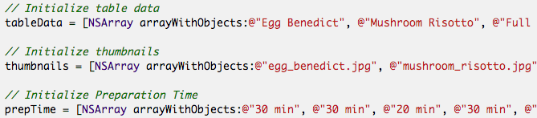
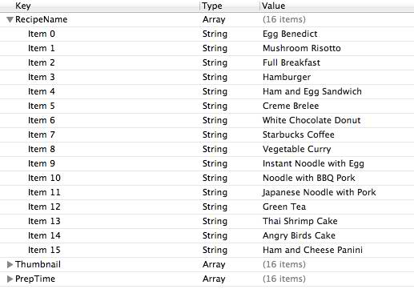
Why externalize table data?
Array definition versus
Property List
Notes:
It’s a good practice to separate static data from the code. But why? What’s the advantage to put the table data into an external source. Let’s ask you to add 50 more recipes in our simple table app. Probably, you’ll go back to your code and put all the new recipes in the initialization
There is nothing wrong doing this. But look at the code! It’s not easy to edit and you have to strictly follow the Objective C syntax. Changing the code may accidentally introduce other errors. That’s not we want. Apparently, it would be better to separate the data and the programming logic (i.e. the code). Does it look better when the table data is stored like this?
In reality, you may not be the one who provides the table data (here, the recipe information). The information may be given by others without iOS programming experience. When we put the data in an external file, it’s easier to read/edit and more understandable.
As you progress, you’ll learn how to put the data in server side (or what-so-called the Cloud). All data in your app are pulled from the server side on demand. It offers one big benefit. For now, any change of the data will require you to build the app and submit it for Apple’s approval. By separating the data and put them in the Cloud, you can change the data anytime without updating your app.

Slide 5
What is a property list?
Property list offers a convenient way to store simple structural data.
Notes:
It usually appears in XML format. If you’ve edited some configuration files in Mac or iPhone before, you may come across files with .plist extension. They are examples of the Property List.
You can’t use property list to save all types of data. The items of data in a property list are of a limited number of types including “array”, “dictionary”, “string”, etc. For details of the supported types, you can refer to the Property List documentation.
Property list is commonly used in iOS app for saving application settings. It doesn’t mean you can’t use it for other purposes. But it is designed for storing small amount of data.

Slide 6
Is it the Best Way to Store Table Data?
No, definitely not.
We use property list to demonstrate how to store table data in an external file. It’s just an example. As you gain more experience, you’ll learn other ways to store the data.

Slide 7
Convert Table Data to Property List

Slide 8
Creating a new Property List
Notes:
We will use our previous sample project

Slide 9
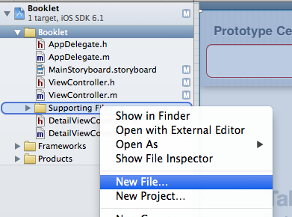
Adding a new file
Notes:
With your table view navigation project open right click on the “Supporting Files” folder and select new file

Slide 10
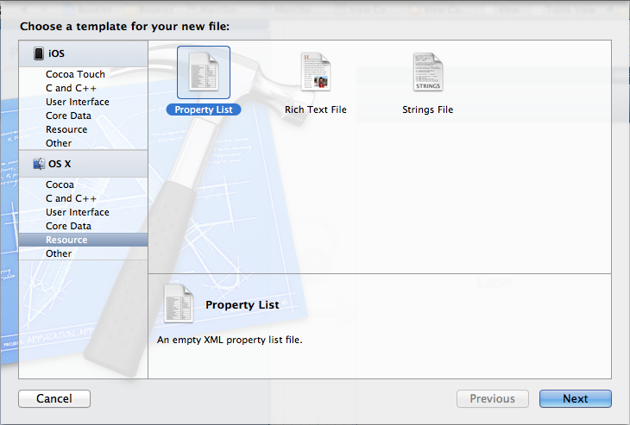
Picking the file type

Slide 11
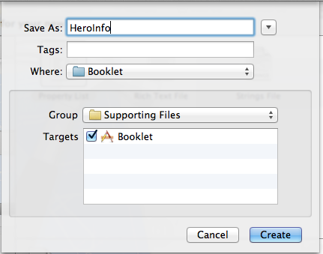
Give the Property List a name

Slide 12
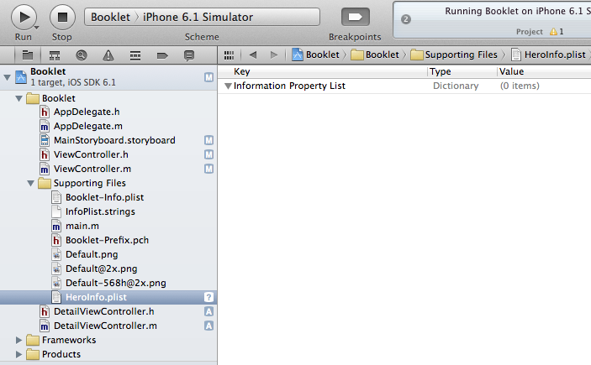
The new file in your project folder

Slide 13
Adding Data

Slide 14
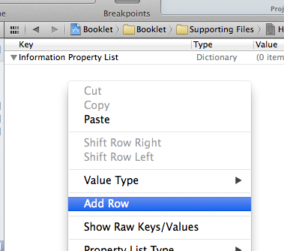
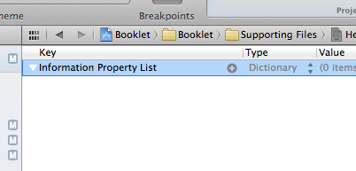
Adding a Row of Data
Click on the first line and then
Click on the plus sign
or
Right click on the empty Plist and select “Add row”

Slide 15
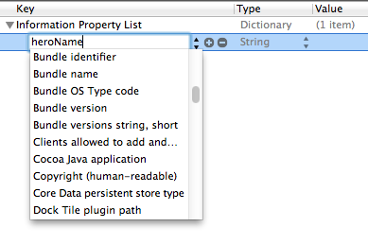
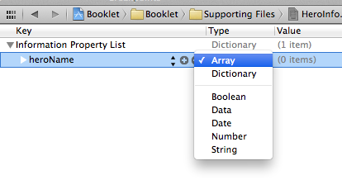
Defining a Row

Slide 16

Our sample rows

Slide 17
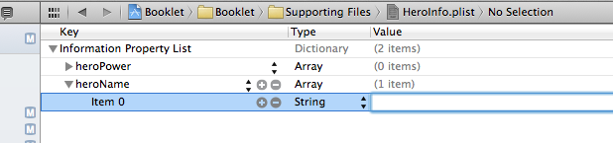
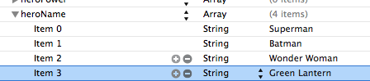
Adding data to each item
Notes:
Make sure you click on the arrow beside heroName to add data to that particular category. Then click on the plus sign you’ll find on the heroName row.

Slide 18
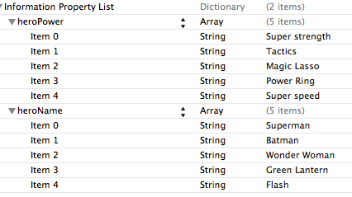
Our sample data

Slide 19
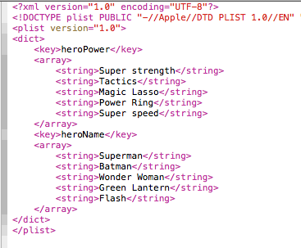
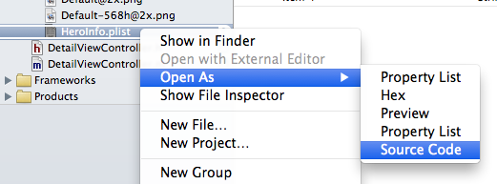
What it actually looks like
Notes:
It is good to be familiar with what the real format of the plist file is. As said earlier it’s basically an XML file.

Slide 20
Coding Plist Access

Slide 21
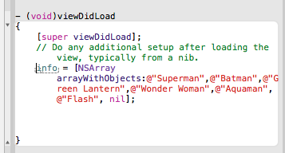
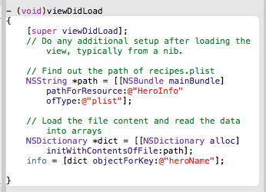
ViewController.m
Old Code
New Code
Notes:
New code explained:
NSString *path = [[NSBundle mainBundle] pathForResource:@"HeroInfo" ofType:@"plist"];
Before reading the “recipes.plist” file, you have to first retrieve the full path of the resource.
NSDictionary *dict = [[NSDictionary alloc] initWithContentsOfFile:path];
You have defined three keys (RecipeName, Thumbnail, PrepTime) in the property list. In the example, each key is associated with a specific array, which is the value. In iOS programming, we use the term dictionary to refer to this key-value pair association. NSDictionary class provides the necessary methods for managing the dictionary. Here, we use the “initWithContentsOfFile” method of NSDictionary class to read the key-value pairs in a property list file.
info = [dict objectForKey:@"heroName"];
These lines of code retrieves the corresponding array with the key we defined earlier.
New Code (ViewController.h viewDidLoad):
- (void)viewDidLoad
{
[super viewDidLoad];
// Do any additional setup after loading the view, typically from a nib.
// Find out the path of recipes.plist
NSString *path = [[NSBundle mainBundle] pathForResource:@"HeroInfo" ofType:@"plist"];
// Load the file content and read the data into arrays
NSDictionary *dict = [[NSDictionary alloc] initWithContentsOfFile:path];
info = [dict objectForKey:@"heroName"];
}

Slide 22
Run the App

Slide 23
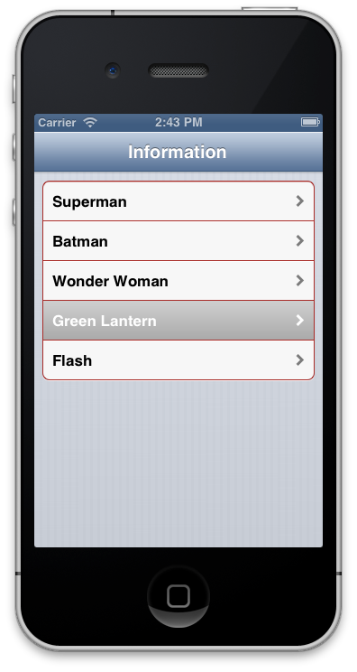
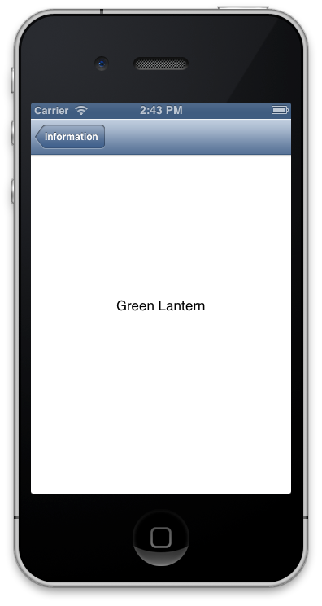
Externally it looks the same

Slide 24
iOS Core Data
Notes:
http://mobile.tutsplus.com/tutorials/iphone/iphone-core-data/
http://www.codigator.com/tutorials/ios-core-data-tutorial-with-example/

Slide 25
What is Core Data?
Core Data is a framework Apple provides to developers that is described as a “schema-driven object graph management and persistence framework.” What does that actually mean? The framework manages where data is stored, how it is stored, data caching, and memory management. It was ported to the iPhone from Mac OS X with the 3.0 iPhone SDK release.
Notes:
Core Data is a powerful unified framework Provided by Apple for persisting data in the applications. It is cheap in terms of processes usage, and relationship between data can also be maintained easily.

Slide 26
Why use Core Data?
The Core Data API allows developers to create and use a relational database, perform record validation, and perform queries using SQL-less conditions. It essentially allows you to interact with SQLite in Objective-C and not have to worry about connections or managing the database schema,
Notes:
It is important to understand why you might want to use Core Data with SQLite for storage over property lists, a custom XML format, or direct SQLite database access.
Most of these features above are familiar to people who have used object-relational mapping (ORM) technologies like those implemented in Ruby on Rails, CakePHP, LINQ or other libraries and frameworks that abstract access to the database. The main benefit to this approach is that it eliminates the development time otherwise necessary to write complex SQL queries and manually handle the SQL and output of those operations.

Slide 27
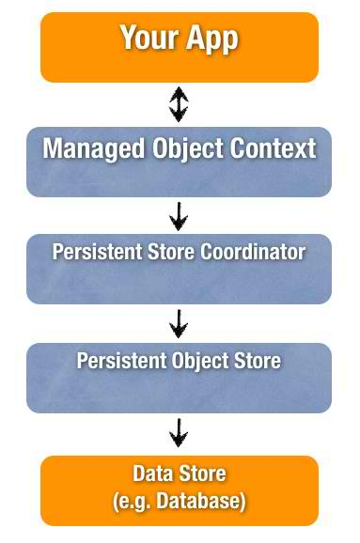
Notes:
Core Data Stack
Managed Object Model – It describes the schema that you use in the app. If you have a database background, think of this as the database schema. However, the schema is represented by a collection of objects (also known as entities). In Xcode, the Managed Object Model is defined in a file with the extension .xcdatamodeld. You can use the visual editor to define the entities and their attributes, as well as, relationships.
Persistent Store Coordinator – SQLite is the default persistent store in iOS. However, Core Data allows developers to setup multiple stores containing different entities. The Persistent Store Coordinator is the party responsible to manage different persistent object stores and save the objects to the stores. Forget about it you don’t understand what it is. You’ll not interact with Persistent Store Coordinator directly when using Core Data.
Managed Object Context – Think of it as a “scratch pad” containing objects that interacts with data in persistent store. Its job is to manage objects created and returned using Core Data. Among the components in the Core Data Stack, the Managed Object Context is the one you’ll work with for most of the time. In general, whenever you need to fetch and save objects in persistent store, the context is the first component you’ll talk to.
http://www.appcoda.com/introduction-to-core-data/

Slide 28
Creating the Project and Adding Core Data

Slide 29
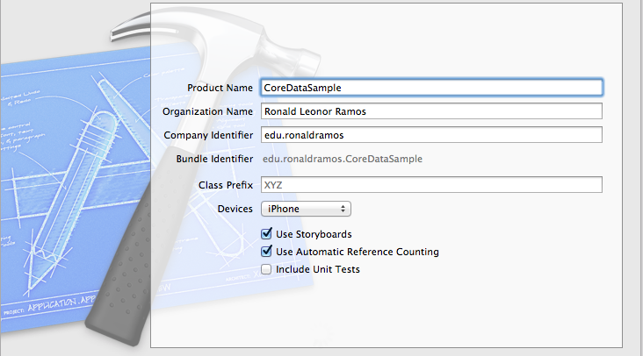
Create a new project

Slide 30
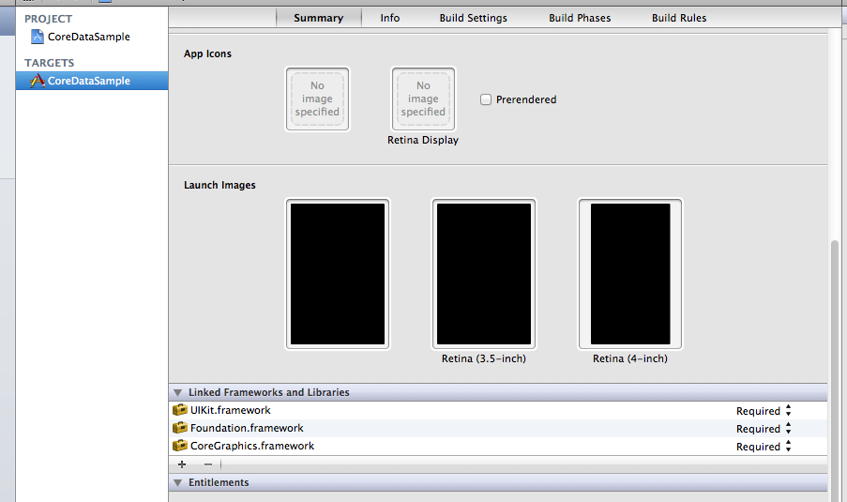
Add CoreData Framework
Notes:
Click in the plus sign

Slide 31
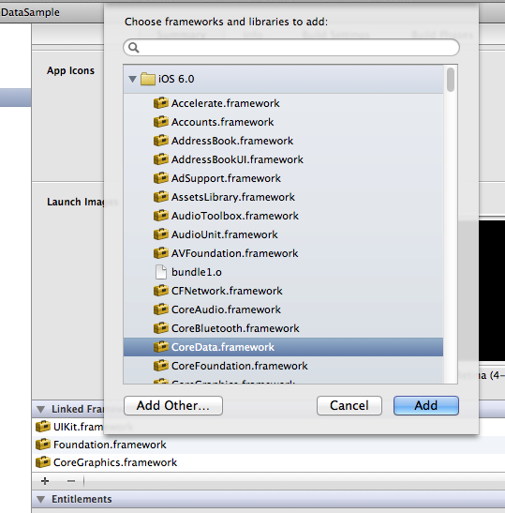
Add CoreData Framework

Slide 32
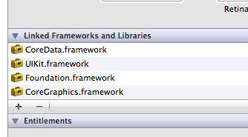
CoreData appears on the list

Slide 33
Adding required CoreData files

Slide 34
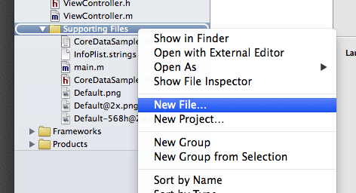
Insert a new file

Slide 35
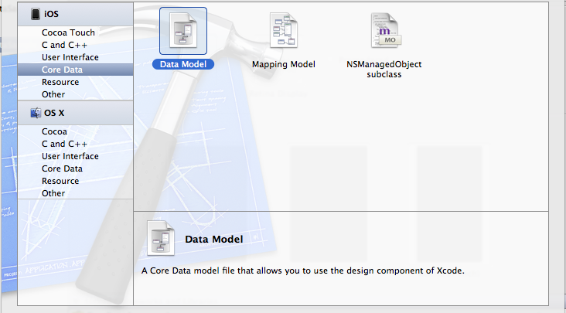
Pick Core Data and select Data Model

Slide 36
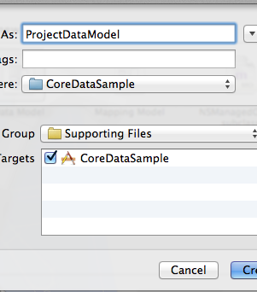
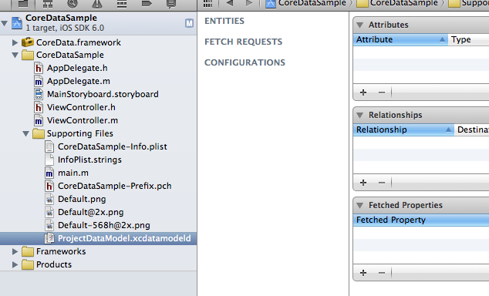
The new datamodel file

Slide 37
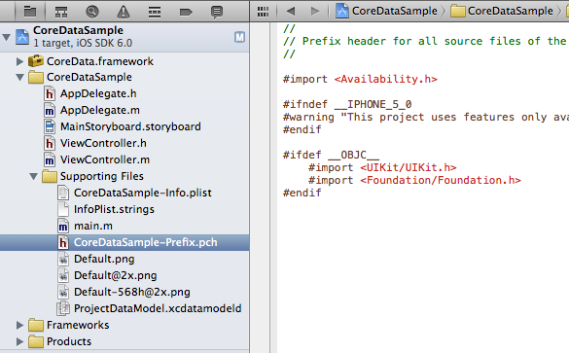
The .pch file

Slide 38
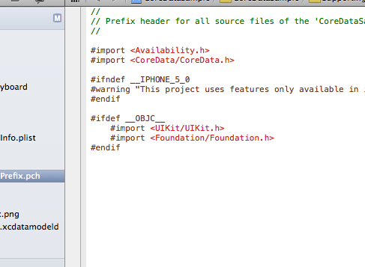
Add a new import
Notes:
#import <CoreData/CoreData.h>

Slide 39
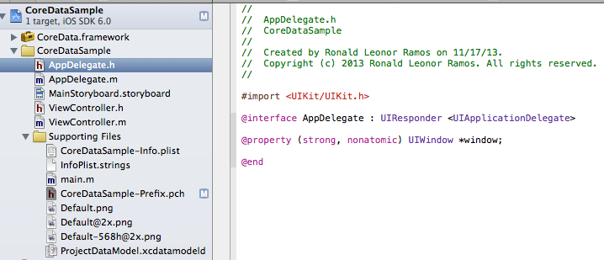
AppDelegate.h

Slide 40
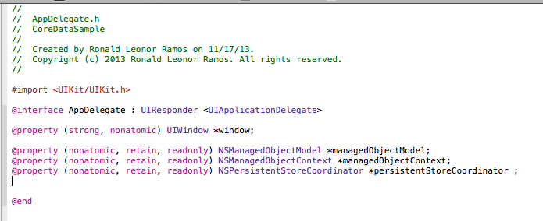
Modify AppDelegate.h
Notes:
Added code:
@property (nonatomic, retain, readonly) NSManagedObjectModel *managedObjectModel;
@property (nonatomic, retain, readonly) NSManagedObjectContext *managedObjectContext;
@property (nonatomic, retain, readonly) NSPersistentStoreCoordinator *persistentStoreCoordinator ;

Slide 41
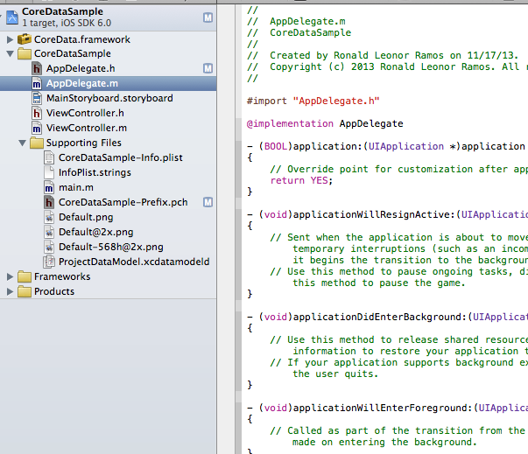
AppDelegate.m

Slide 42
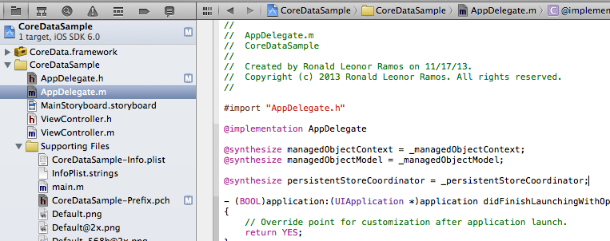
Modify AppDelegate.m
Notes:
@synthesize managedObjectContext = _managedObjectContext;
@synthesize managedObjectModel = _managedObjectModel;
@synthesize persistentStoreCoordinator = _persistentStoreCoordinator;

Slide 43
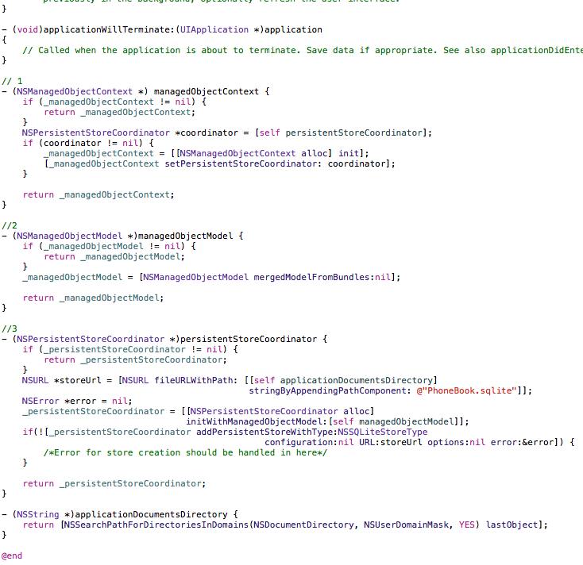
Additional methods for AppDelegate.m
Notes:
1) Method will be returning “managedObjectContext” object associated with out data base file (Sqlite ).
2) Method will be returning “managedObjectModel” object associated with out data base file (Sqlite ).
3) Method will be returning “persistentStoreCoordinator” object associated with out data base file (Sqlite ).
Additional Code:
// 1
- (NSManagedObjectContext *) managedObjectContext {
if (_managedObjectContext != nil) {
return _managedObjectContext;
}
NSPersistentStoreCoordinator *coordinator = [self persistentStoreCoordinator];
if (coordinator != nil) {
_managedObjectContext = [[NSManagedObjectContext alloc] init];
[_managedObjectContext setPersistentStoreCoordinator: coordinator];
}
return _managedObjectContext;
}
//2
- (NSManagedObjectModel *)managedObjectModel {
if (_managedObjectModel != nil) {
return _managedObjectModel;
}
_managedObjectModel = [NSManagedObjectModel mergedModelFromBundles:nil];
return _managedObjectModel;
}
//3
- (NSPersistentStoreCoordinator *)persistentStoreCoordinator {
if (_persistentStoreCoordinator != nil) {
return _persistentStoreCoordinator;
}
NSURL *storeUrl = [NSURL fileURLWithPath: [[self applicationDocumentsDirectory]
stringByAppendingPathComponent: @"PhoneBook.sqlite"]];
NSError *error = nil;
_persistentStoreCoordinator = [[NSPersistentStoreCoordinator alloc]
initWithManagedObjectModel:[self managedObjectModel]];
if(![_persistentStoreCoordinator addPersistentStoreWithType:NSSQLiteStoreType
configuration:nil URL:storeUrl options:nil error:&error]) {
/*Error for store creation should be handled in here*/
}
return _persistentStoreCoordinator;
}
- (NSString *)applicationDocumentsDirectory {
return [NSSearchPathForDirectoriesInDomains(NSDocumentDirectory, NSUserDomainMask, YES) lastObject];
}

Slide 44
Generating our model

Slide 45
Some Definitions
Persistent Store Coordinator:
As the name suggest it is a coordinator , that coordinates between manage object context and low level file saved in our data base (Sqlite file) , you do not have to think much about it as this stage. We are not gonna use it directly, it will only be used while setting NSManageObjectContext . Linking it to our Persistent store coordinator which in turn will be linked with our Sqlite file (PhoneBook.sqlite for our case) .
Managed object context
You can think of a managed object context as an intelligent scratch pad. When you fetch objects from a persistent store, you bring temporary copies onto the scratch pad . You can then modify those objects however you like. Unless you actually save those changes, however, the persistent store remains unaltered.
This will be most important as we will be using it to make queries on our data (fetching , updating , deleting and adding data).
NSManageObject Model
A managed object model is an instance of the NSManagedObjectModel class. It describes a schema (contains definitions) for objects (also called entities )—that you use in your application.
Properties (Attributes of entity )
An entity’s properties are its attributes and relationships. Amongst other features, each property has a name and a type. A property name cannot be the same as any no-parameter method name of NSObject or NSManagedObject—for example, you cannot give a property the name “description” (see NSPropertyDescription).

Slide 46
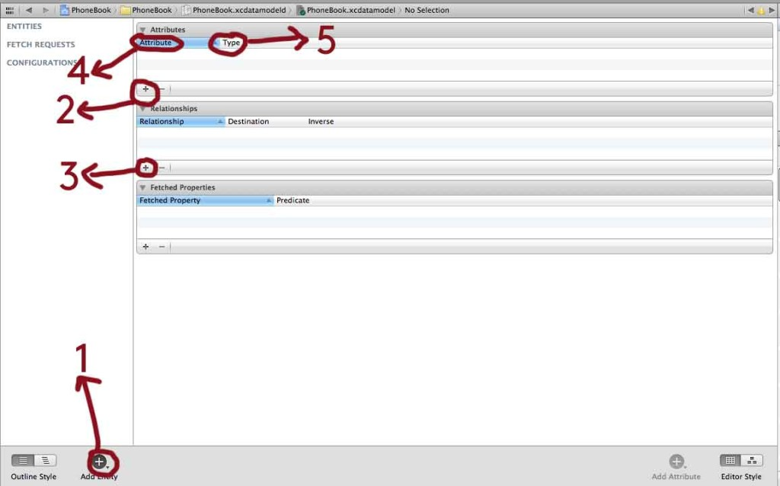
Creating an Entity
Notes:
1) Tap this Button to add New Entity
2) Tap this to Add new Property (Attribute) to selected Entity.
3) Tap this to Add new Relationship to selected Entity.
4) This Column will tell you the Attribute name.
5) This Column will tell you the Attribute Type.

Slide 47
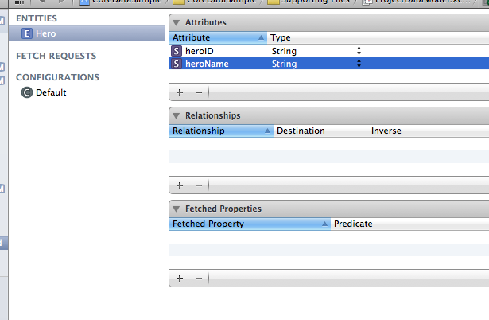
Creating an Entity
Attributes
Entity name
Add/Delete Attributes

Slide 48
Auto Generating NSManageObject class

Slide 49
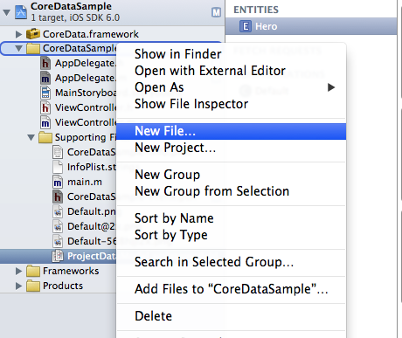
Add a new file

Slide 50
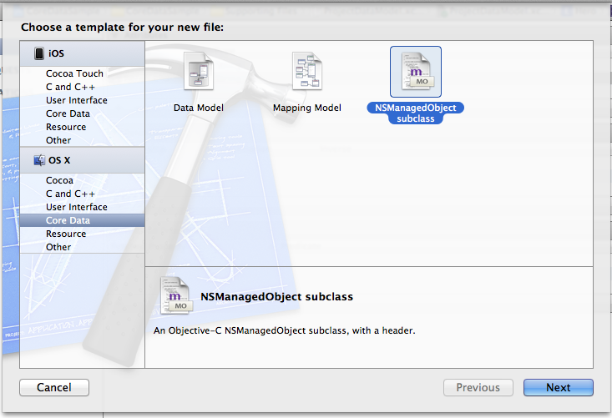
Select NSManagedObject
Notes:
This is similar to a database schema

Slide 51
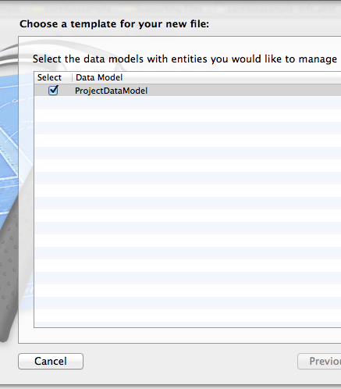
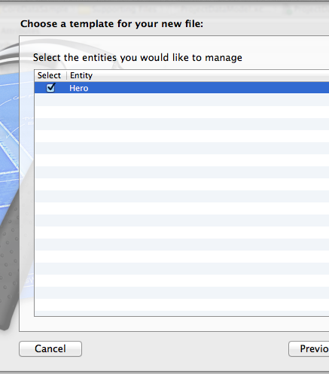
Select your data source
Entity you created!
Data model you created!

Slide 52
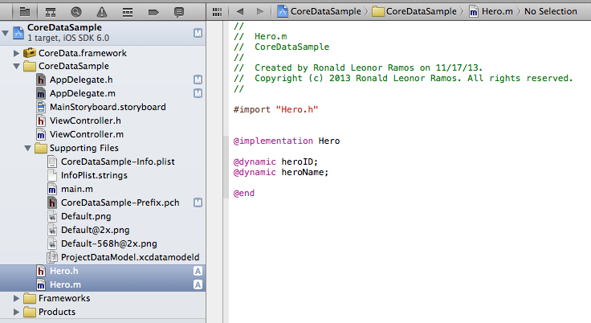
The Autogenerated Hero stubs

Slide 53

Run the App

Slide 54
Preparing to Save Data

Slide 55
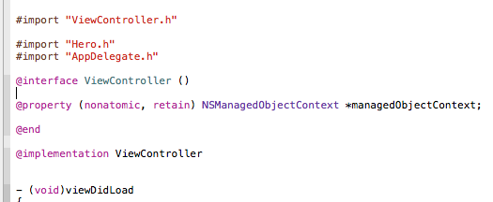
Modify ViewController.m
Add this!
Notes:
ViewController.m
#import "ViewController.h"
#import "Hero.h"
#import "AppDelegate.h"
@interface ViewController ()
@property (nonatomic, retain) NSManagedObjectContext *managedObjectContext;
@end
@implementation ViewController
- (void)viewDidLoad
{
[super viewDidLoad];
// Do any additional setup after loading the view, typically from a nib.
}
- (void)didReceiveMemoryWarning
{
[super didReceiveMemoryWarning];
// Dispose of any resources that can be recreated.
}
@end

Slide 56

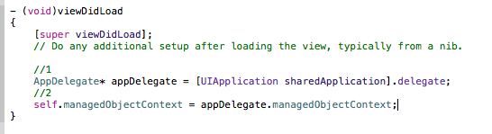
Modify ViewController.m
imports
viewDidLoad
Notes:
Notes (Comments serve as the number guide)
Make an instance of AppDelegate .
Referencing manageObjectContext : manageObjectContext of the Controller points to AppDelegate’s manageObjectContext object.
CODE:
#import "ViewController.h"
#import "Hero.h"
#import "AppDelegate.h"
@interface ViewController ()
@property (nonatomic, retain) NSManagedObjectContext *managedObjectContext;
@end
@implementation ViewController
- (void)viewDidLoad
{
[super viewDidLoad];
// Do any additional setup after loading the view, typically from a nib.
//1
AppDelegate* appDelegate = [UIApplication sharedApplication].delegate;
//2
self.managedObjectContext = appDelegate.managedObjectContext;
}
- (void)didReceiveMemoryWarning
{
[super didReceiveMemoryWarning];
// Dispose of any resources that can be recreated.
}
@end

Slide 57
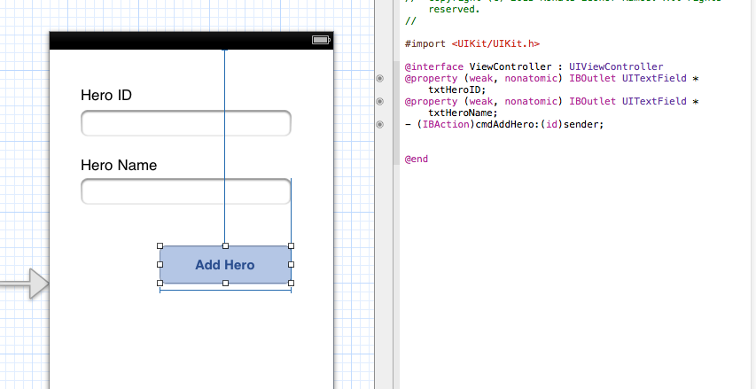
Modify Main Storyboard

Slide 58
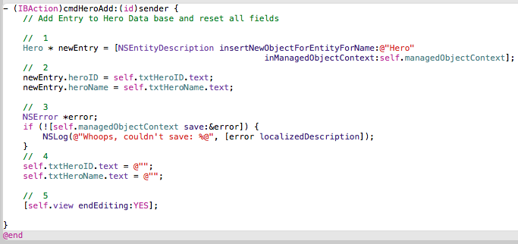
Code for Button
Notes:
Explanation:
1) Creates, configures, and returns an instance of the Record class .
2) We add Values to different Attributes of Record class object.
3) Entity value is saved to data base (Without this our data won’t persist in the memory ). As i already told you its like scratch pad unless you save the work. it will be lost when scratch pad is erased.
4) Removing All Text field in Texfields.
5) Dismissing Keyboard.
CODE
- (IBAction)cmdAddHero:(id)sender {
// Add Entry to Hero Data base and reset all fields
// 1
Hero * newEntry = [NSEntityDescription insertNewObjectForEntityForName:@"Hero"
inManagedObjectContext:self.managedObjectContext];
// 2
newEntry.heroID = self.txtHeroID.text;
newEntry.heroName = self.txtHeroName.text;
// 3
NSError *error;
if (![self.managedObjectContext save:&error]) {
NSLog(@"Whoops, couldn't save: %@", [error localizedDescription]);
}
// 4
self.txtHeroID.text = @"";
self.txtHeroName.text = @"";
// 5
[self.view endEditing:YES];
}

Slide 59
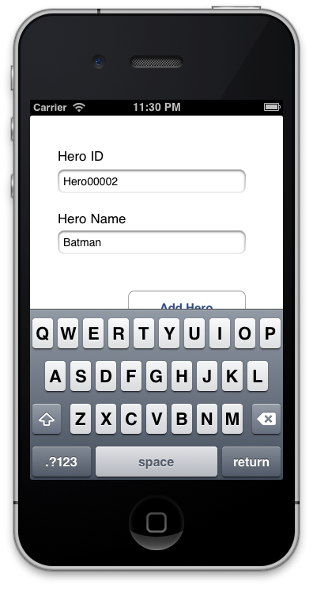
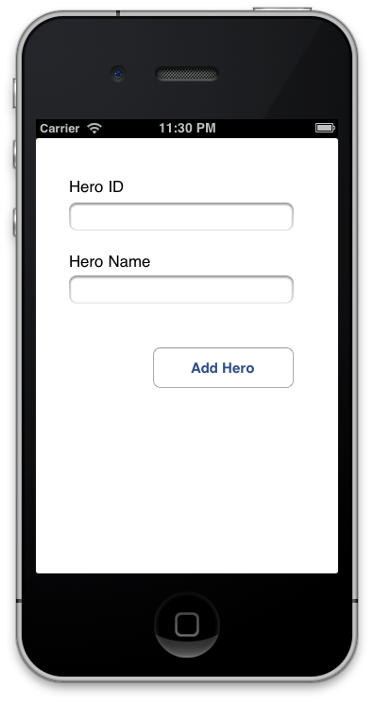
Run the App

Slide 60
Viewing Data

Slide 61
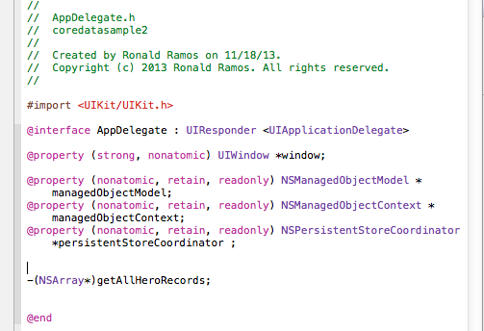
Modify AppDelegate.h

Slide 62
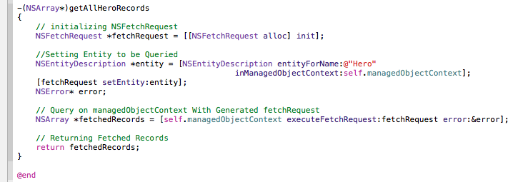
Modify AppDelegate.m
Notes:
Code added at the end:
-(NSArray*)getAllHeroRecords
{
// initializing NSFetchRequest
NSFetchRequest *fetchRequest = [[NSFetchRequest alloc] init];
//Setting Entity to be Queried
NSEntityDescription *entity = [NSEntityDescription entityForName:@"Hero"
inManagedObjectContext:self.managedObjectContext];
[fetchRequest setEntity:entity];
NSError* error;
// Query on managedObjectContext With Generated fetchRequest
NSArray *fetchedRecords = [self.managedObjectContext executeFetchRequest:fetchRequest error:&error];
// Returning Fetched Records
return fetchedRecords;
}
@end

Slide 63


Add A Custom Controller Class

Slide 64

Modify the StoryBoard
Embed in a navigation controller
Add a second controller with a
Table view control
Notes:
Embed the first view controller in a navigation bar control
Then add a button to the first view controller
Add a second ViewController to the storyboard and associate it to your custom ViewController class
Add a push segue from the button to the second Viewcontroller

Slide 65

Associate Custom Class with Second View Controller

Slide 66

Give an identifier to your prototype cell

Slide 67

Modify DataViewController.h
Notes:
DataViewController.h is your custom class
Code:
//
// DataViewController.h
// coredatasample2
//
// Created by Ronald Ramos on 11/25/13.
// Copyright (c) 2013 Ronald Ramos. All rights reserved.
//
#import <UIKit/UIKit.h>
@interface DataViewController : UIViewController <UITableViewDataSource, UITableViewDelegate>
@property (strong, nonatomic) UITableView *tableView;
@end

Slide 68

Modify DataViewController.m: Imports and ViewDidLoad
Notes:
Code:

Slide 69

Modify DataViewController.m: Table methods
Notes:
Complete Code:
DataViewController.m
//
// DataViewController.m
// coredatasample2
//
// Created by Ronald Ramos on 11/25/13.
// Copyright (c) 2013 Ronald Ramos. All rights reserved.
//
#import "DataViewController.h"
#import "Hero.h"
#import "AppDelegate.h"
@interface DataViewController ()
@property (nonatomic,strong)NSArray* fetchedHerosArray;
@end
@implementation DataViewController
- (id)initWithNibName:(NSString *)nibNameOrNil bundle:(NSBundle *)nibBundleOrNil
{
self = [super initWithNibName:nibNameOrNil bundle:nibBundleOrNil];
if (self) {
// Custom initialization
}
return self;
}
- (void)viewDidLoad
{
[super viewDidLoad];
// Do any additional setup after loading the view.
AppDelegate* appDelegate = [UIApplication sharedApplication].delegate;
// Fetching Records and saving it in "fetchedRecordsArray" object
self.fetchedHerosArray = [appDelegate getAllHeroRecords];
[self.tableView reloadData];
}
- (void)didReceiveMemoryWarning
{
[super didReceiveMemoryWarning];
// Dispose of any resources that can be recreated.
}
- (NSInteger)numberOfSectionsInTableView:(UITableView *)tableView
{
// Return the number of sections.
return 1;
}
- (NSInteger)tableView:(UITableView *)tableView numberOfRowsInSection:(NSInteger)section
{
// Return the number of rows in the section.
return [self.fetchedHerosArray count];
}
- (UITableViewCell *)tableView:(UITableView *)tableView cellForRowAtIndexPath:(NSIndexPath *)indexPath
{
static NSString *CellIdentifier = @"bida";
UITableViewCell *cell = [tableView dequeueReusableCellWithIdentifier:CellIdentifier forIndexPath:indexPath];
Hero *hero = [self.fetchedHerosArray objectAtIndex:indexPath.row];
cell.textLabel.text = [NSString stringWithFormat:@"%@, %@", hero.heroID, hero.heroName ];
return cell;
}
@end

Slide 70


Run the App

Slide 71
Ronald L. Ramos (Contact information)
Mobile: 09298874076
Email: rlramos@smart.com.ph
Facebook: rlramos@gmail.com
Twitter: Taleweaver
My Lego Blog: brickstories.blogspot.com

Slide 72
Thank You!

