Slide 1



iOS App Development
Day 2

Slide 2
Using the Text Field
Data Input and the on screen keyboard

Slide 3
The user interface

Slide 4
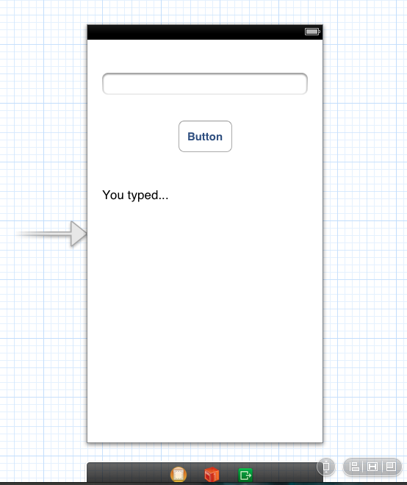
The user interface
Notes:
The user types a value in the text field and when the button is clicked the text is copied into the label

Slide 5
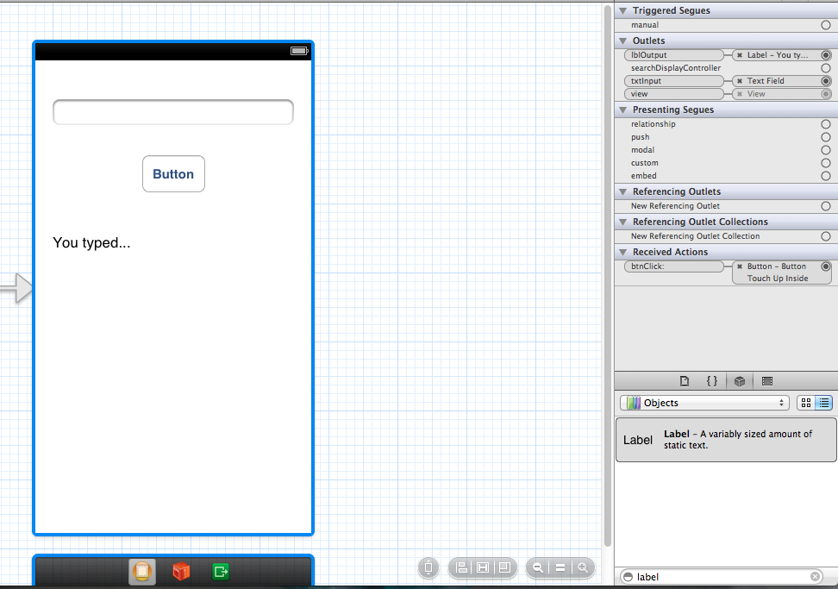
Connections
Notes:
IBOutlet is a special keyword that is used only to tell Xcode to treat the object as an outlet. It’s actually defined as nothing so it has no effect at compile time.
Xcode established a connection from the view controller to the text field.By establishing the connection between the view controller and the text field, the text that the user enters can be passed to the view controller. As Xcode did with the changeGreeting: method declaration, it indicates that the connection has been made by displaying a filled-in circle to the left of the text field declaration.
Note: Earlier versions of Xcode add an @synthesize directive in the implementation block for each property you declare using the Control-drag approach. Because the compiler automatically synthesizes accessor methods, these directives are unnecessary. You may safely delete them.
Now add an outlet for the label and configure the connection. Establishing a connection between the view controller and the label allows the view controller to update the label with a string that contains the user’s text.

Slide 6
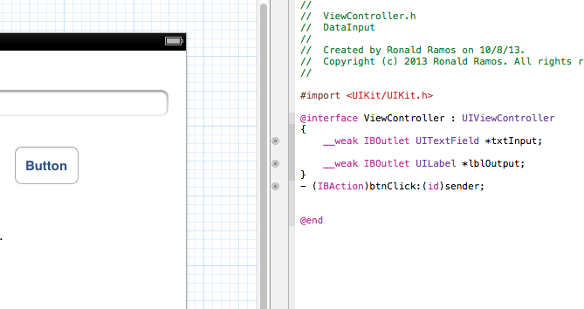
Connections (viewcontroller.h)

Slide 7
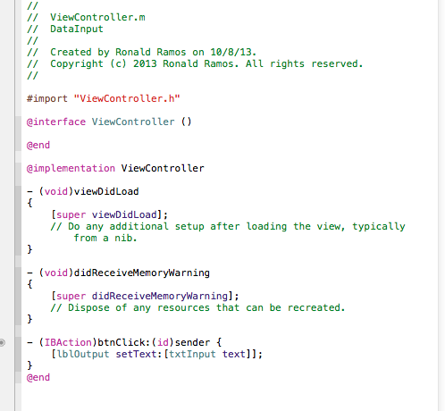
viewcontroller.m

Slide 8
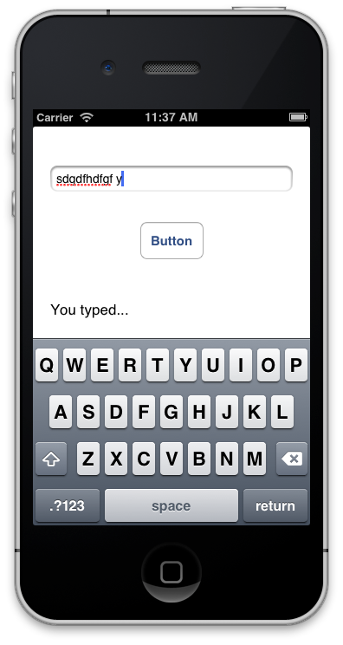
Run the App!
Notice how the keyboard does not disappear no matter where you click on the screen or no matter how many times you click on return.

Slide 9
Making the keyboard disappear

Slide 10
Delegates

Slide 11
The Delegate Pattern
Delegation is a simple and powerful pattern in which one object in a program acts on behalf of, or in coordination with, another object.
The idea behind delegates is that instead of class A executing some code, it tells it’s delegate to execute that code. The delegate is tied to another class (let’s call it class B).
  In order to facilitate this, class A creates something called a protocol. This protocol has a list of methods in it (with no definition).
  Class A then has an instance of the protocol as a property.
  Class B has to implement the protocol defined in class A.
  Lastly, when class A is created, it’s delegate property is set to class B.

Slide 12
Delegate Behavior
Let's assume an object A calls object B to perform an action, once the action is complete object A should know that B has completed the task and take necessary action. This is achieved with the help of delegates.
The key concepts in the above example are:
  A is delegate object of B
  B will have a reference of A
  A will implement the delegate methods of B.
  B will notify A through the delegate methods.

Slide 13
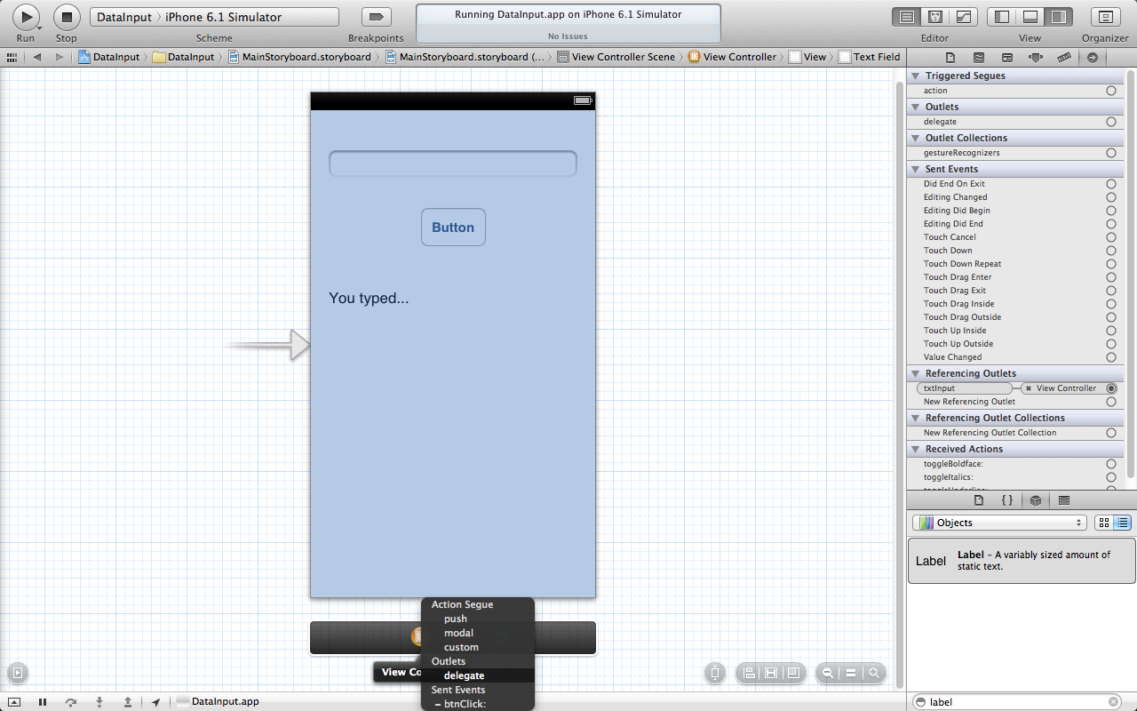
Setting up Text Field as a delegate of ViewController
Control-Drag the TextField to the yellow ViewController at the bottom of the iphone screen
You will get a pop up menu asking you what connection you want to set.
Select “delegate”
Notes:
In an iOS app, the keyboard is shown automatically when an element that allows text entry becomes the first responder; it is dismissed automatically when the element loses first responder status. (Recall that the first responder is the object that first receives notice of various events, such as tapping a text field to bring up the keyboard.) Although there’s no way to directly send a message to the keyboard from your app, you can make it appear or disappear as a side effect of toggling the first responder status of a text-entry UI element.
First Responder status is known as “getting focus” in other graphical based UI programming.

Slide 14
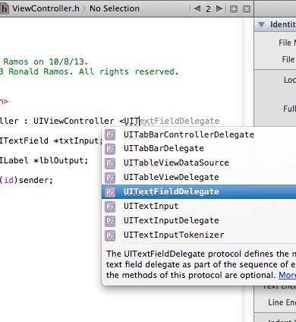
Referencing the UITextLabelDelegate
We add a reference to ViewController.h

Slide 15
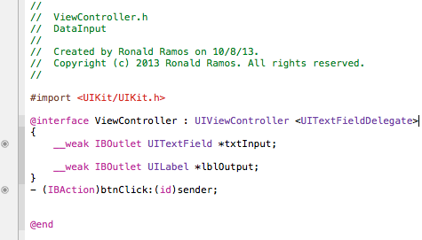
The TextFieldDelegate added to ViewController.h

Slide 16
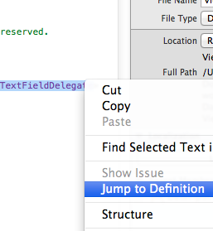
Getting the method definitions of the delegate
In ViewController.h select UITextFieldDelegate and right click on it
Select “Jump to Definition”

Slide 17
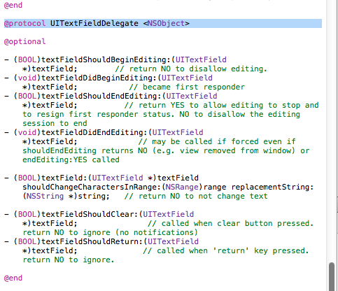
Getting the method definitions of the delegate
You will be taken to the template of the UITextFieldDelegate
Notice the skeleton methods defined in this section of code
These skeleton methods are know as the Protocols of the UITextFieldDelegate
Notes:
The UITextFieldDelegate protocol is defined by the UIKit framework, and it includes the textFieldShouldReturn: method that the text field calls when the user taps the Return button (regardless of the actual title of this button).
Note: A protocol is basically just a list of methods. If a class conforms to (or adopts) a protocol, it guarantees that it implements the required methods of a protocol. (Protocols can also include optional methods.) A delegate protocol specifies all the messages an object might send to its delegate.

Slide 18
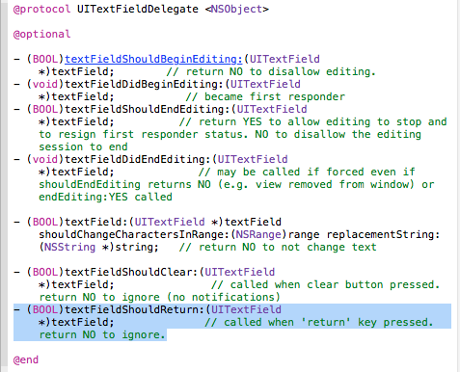
Getting the method definitions of the delegate
Copy the method skeleton for “textFieldShallReturn
This method is activated whenever the user taps on the “Return” button on the iOS keyboard
Notes:
Because you set the view controller as the text field’s delegate, you can implement this method to force the text field to lose first responder status by sending it the “resignFirstResponder” message—which has the side effect of dismissing the keyboard.

Slide 19
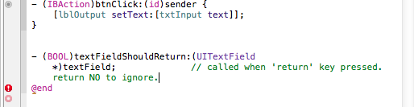
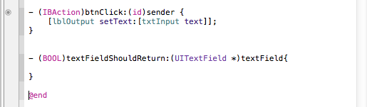
Paste the method skeleton to ViewController.m
Notes:
After copying the method skeleton from the UIKIT file we paste it in ViewController.m so that we can implement its code

Slide 20
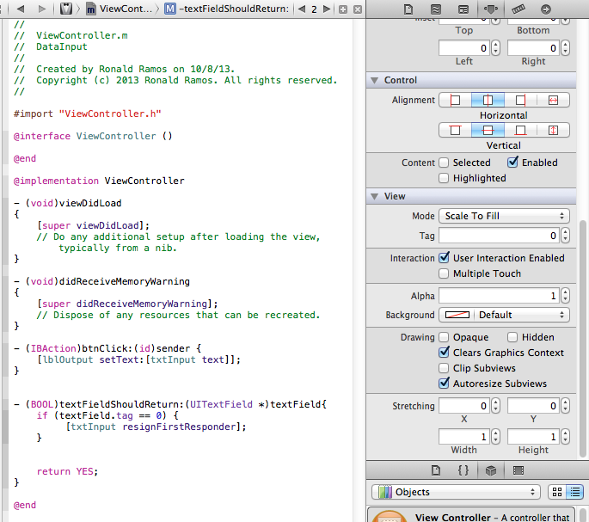
Implementing the method
Notes:
In this app, it’s not really necessary to test the (textField.tag == 0) expression because there’s only one text field. This is a good pattern to use, though, because there may be occasions when your object is the delegate of more than one object of the same type and you might need to differentiate between them.
Complete code for ViewController.m
//
// ViewController.m
// DataInput
//
// Created by Ronald Ramos on 10/8/13.
// Copyright (c) 2013 Ronald Ramos. All rights reserved.
//
#import "ViewController.h"
@interface ViewController ()
@end
@implementation ViewController
- (void)viewDidLoad
{
[super viewDidLoad];
// Do any additional setup after loading the view, typically from a nib.
}
- (void)didReceiveMemoryWarning
{
[super didReceiveMemoryWarning];
// Dispose of any resources that can be recreated.
}
- (IBAction)btnClick:(id)sender {
[lblOutput setText:[txtInput text]];
}
- (BOOL)textFieldShouldReturn:(UITextField *)textField{
if (textField.tag == 0) {
[txtInput resignFirstResponder];
}
return YES;
}
@end

Slide 21
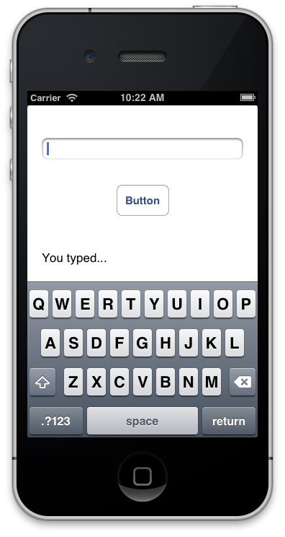
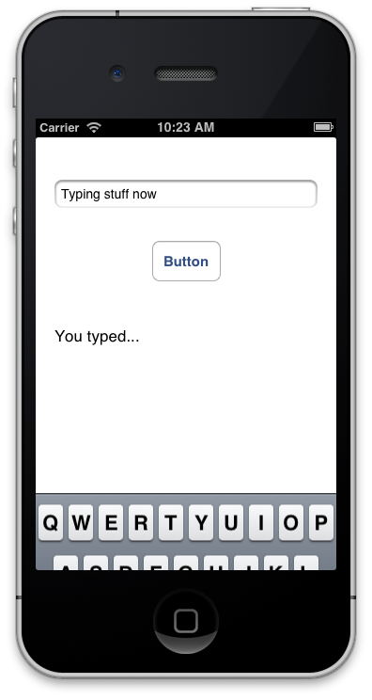
Run the app!
Tapping in the text box brings out the keyboard
Tapping on “Return” hides it again

Slide 22
Message Box in iOS

Slide 23
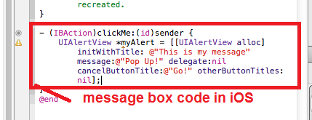
Message Box code
Notes:
Complete Code:
UIAlertView *myAlert = [[UIAlertView alloc]
initWithTitle: @"This is my message"
message:@"Pop Up!"
delegate:nil
cancelButtonTitle:@"Go!"
otherButtonTitles:nil];
[myAlert show];

Slide 24
Alert Views
Alert views display a concise and informative alert message to the user. Alert views convey important information about an app or the device, interrupting the user and requiring them to stop what they’re doing to choose an action or dismiss the alert.
Purpose. Alert views allow users to:
  Be immediately informed of critical information
  Make a decision about a course of action
Notes:
For example, iOS uses alerts to warn the user that battery power is running low, so they can connect a power adapter before their workflow is interrupted. An alert view appears on top of app content, and must be manually dismissed by the user before he can resume interaction with the app.

Slide 25
Table Views

Slide 26
The App’s UI

Slide 27
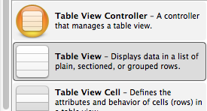
Table View control

Slide 28
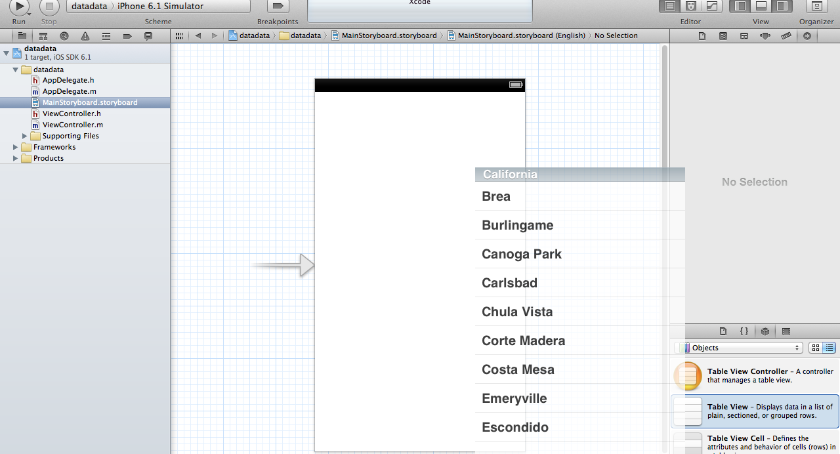
Drag the Table view to your storyboard

Slide 29
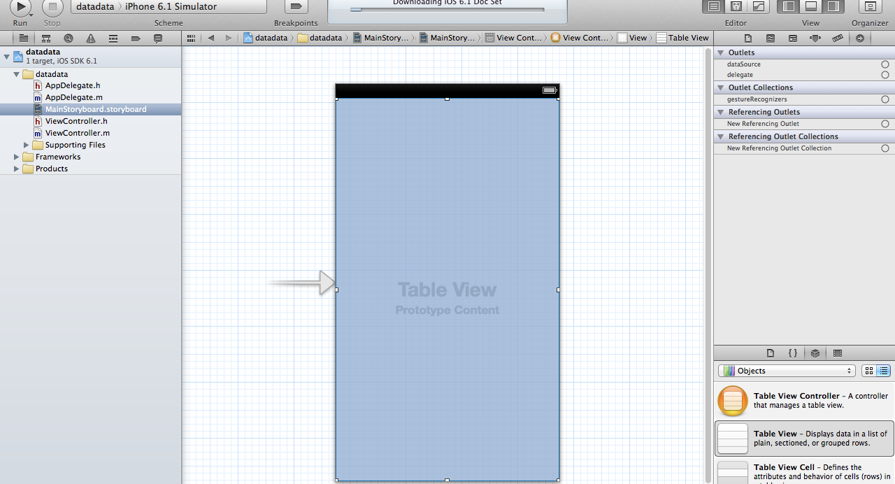
Make sure the Table View fills the entire storyboard

Slide 30
Completing the Code

Slide 31
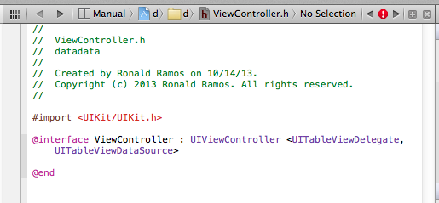
Modify viewcontroller.h
Notes:
Append “<UITableViewDelegate, UITableViewDataSource>” after “UIViewController”.
The “UITableViewDelegate” and “UITableViewDataSource” are known as protocol in Objective-C. Basically, in order to display data in Table View, we have to conform to the requirements defined in the protocols and implement all the mandatory methods.

Slide 32
UITABLEVIEW
The UITableView, the actual class behind the Table View, is designed to be flexible to handle various types of data. You may display a list of countries or contact names.
So how do you tell UITableView the list of data to display? UITableViewDataSource is the answer. It’s the link between your data and the table view. The UITableViewDataSource protocol declares two required methods (tableView:cellForRowAtIndexPath and tableView:numberOfRowsInSection) that you have to implement. Through implementing these methods, you tell Table View how many rows to display and the data in each row.
UITableViewDelegate, on the other hand, deals with the appearance of the UITableView. Optional methods of the protocols let you manage the height of a table row, configure section headings and footers, re-order table cells, etc. We do not change any of these methods in this example. Let’s leave them for the next tutorial.
Notes:
The UITableView, the actual class behind the Table View, is designed to be flexible to handle various types of data. You may display a list of countries or contact names. Or like this example, we’ll use the table view to present a list of recipes. So how do you tell UITableView the list of data to display? UITableViewDataSource is the answer. It’s the link between your data and the table view. The UITableViewDataSource protocol declares two required methods (tableView:cellForRowAtIndexPath and tableView:numberOfRowsInSection) that you have to implement. Through implementing these methods, you tell Table View how many rows to display and the data in each row.
UITableViewDelegate, on the other hand, deals with the appearance of the UITableView. Optional methods of the protocols let you manage the height of a table row, configure section headings and footers, re-order table cells, etc. We do not change any of these methods in this example. Let’s leave them for the next tutorial.

Slide 33
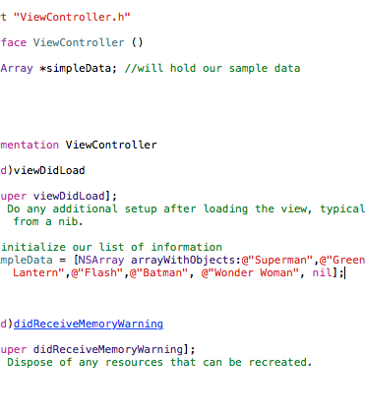
Viewcontroller.m
Next, select “SimpleTableViewController.m” and define an instance variable for holding the table data.
In the “viewDidLoad” method, add the following code to initialize the “tableData” array. We initialize an array with a list of recipes.
In Objective C, NSArray is the class for creating and managing array. You can use NSArray to create static array for which the size is fixed. If you need a dynamic array, use NSMutableArray instead.
Notes:
NSArray offers a set of factory methods to create an array object. In our code, we use “arrayWithObjects” to instantiate a NSArray object and preload it with the specific elements (e.g. Hamburger).
You can also use other built-in methods to query and manage the array.

Slide 34
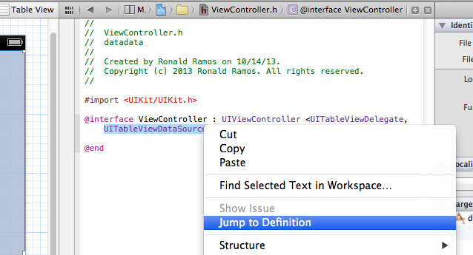
Methods to be implemented
Notes:
Rght click on UITableViewDataSource and select Jump to Definition.
we have to add two datasource methods: “tableView:numberOfRowsInSection” and “tableView:cellForRowAtIndexPath”. These two methods are part of the UITableViewDataSource protocol. It’s mandatory to implement the methods when configuring a UITableView. The first method is used to inform the table view how many rows are in the section. So let’s add the below code. The “count” method simply returns the number of items in the “tableData” array.

Slide 35
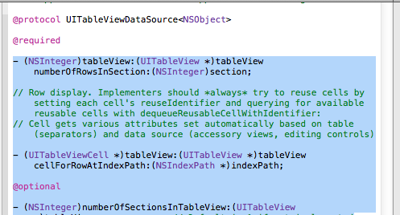
Methods to be implemented
Notes:
Copy the following items

Slide 36
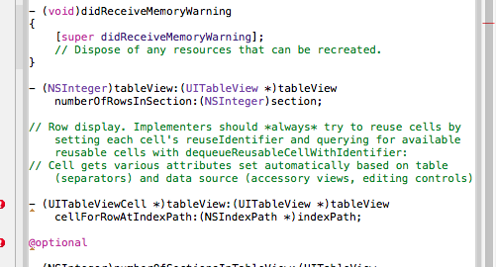
Code pasted in Viewcontroller.m

Slide 37
numberOfRowsInSection
- (NSInteger)tableView:(UITableView *)tableView numberOfRowsInSection:(NSInteger)section
{
return [simpleData count];
}
Notes:
The first method is used to inform the table view how many rows are in the section.

Slide 38
cellForRowAtIndexPath
- (UITableViewCell *)tableView:(UITableView *)tableView cellForRowAtIndexPath:(NSIndexPath *)indexPath
{
static NSString *simpleTableIdentifier = @"SimpleTableItem";
UITableViewCell *cell = [tableView dequeueReusableCellWithIdentifier:simpleTableIdentifier];
if (cell == nil) {
cell = [[UITableViewCell alloc] initWithStyle:UITableViewCellStyleDefault reuseIdentifier:simpleTableIdentifier];
}
cell.textLabel.text = [simpleData objectAtIndex:indexPath.row];
return cell;
}

Slide 39
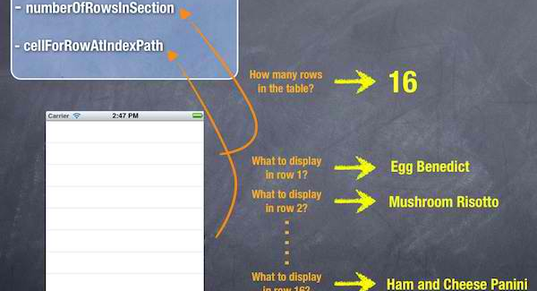
cellForRowAtIndexPath: What happens

Slide 40
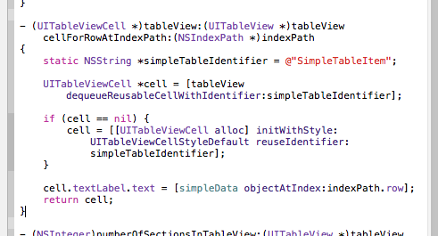
The Code

Slide 41
Connect DataSource and Delegate

Slide 42
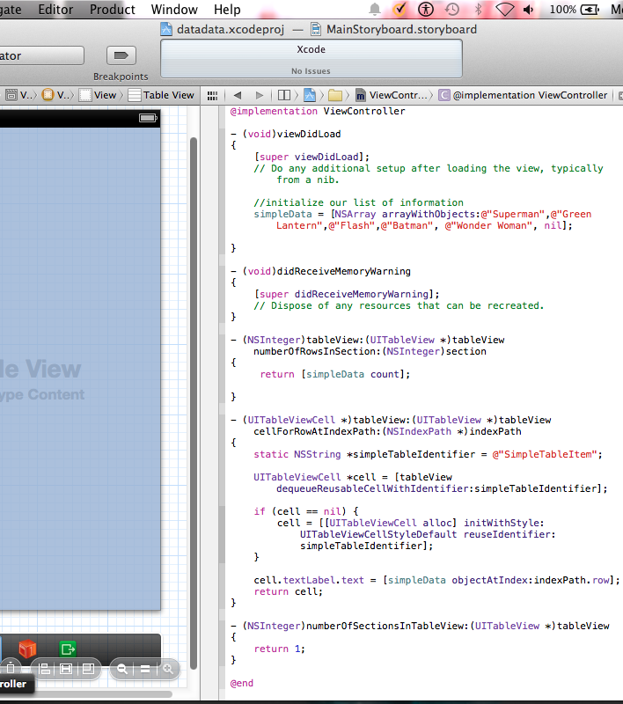
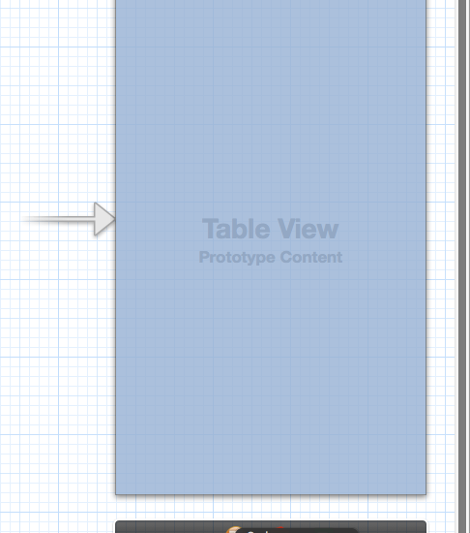
Control-drag to VIEWCONTROLLER

Slide 43
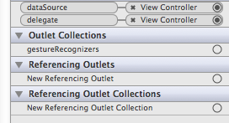
Connection Inspector

Slide 44
Run the App

Slide 45
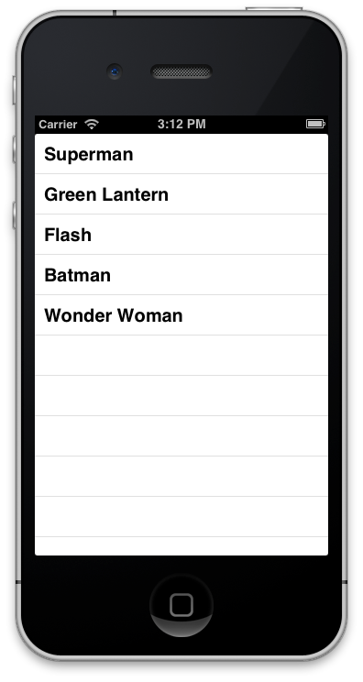
The App

Slide 46
The Navigation Controller
A practical example
Part 1
DLS-CSB SMIT IS
iOS Dev
Ronald L. Ramos

Slide 47
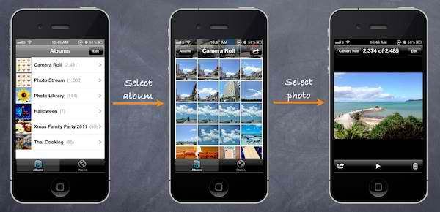
Navigation Controller
Notes:
Like table view, navigation controller is another UI element you commonly find in iOS app. It provides a drill-down interface for hierarchical content. Take a look at the built-in Photos app, YouTube, and Contacts. They’re all built using Navigation Controller to display hierarchical content. Usually table view and navigation controller work hand in hand for most of the apps. This doesn’t mean you have to use both together, however.

Slide 48
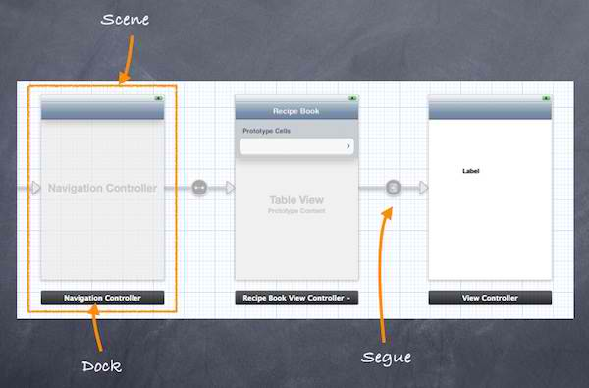
Storyboards
Notes:
With Storyboards, all screens are stored in a single file. This gives you a conceptual overview of the visual representation for the app and shows you how the screens are connected. Xcode provides a built-in editor to layout the Storyboards. You can define the transition (known as segues) between various screens simply using point and click. This doesn’t mean you do not need to write code for the user interface. But Storyboards significantly reduce the amount of code you need to write. Here is a sample screenshot to show you how Storyboards look like in Xcode.

Slide 49
Scenes and Segues
When working with Storyboards, Scene and Segues are two terms you always come across. Within a Storyboard, a scene refers to a single view controller and its view. Each scene has a dock, which is used primarily to make action and outlet connections between the view controller and its views.
Segue sits between two scenes and manages the transition between two scenes. Push and Modal are two common types of transition.

Slide 50
Creating Navigation Controllers with Storyboards

Slide 51
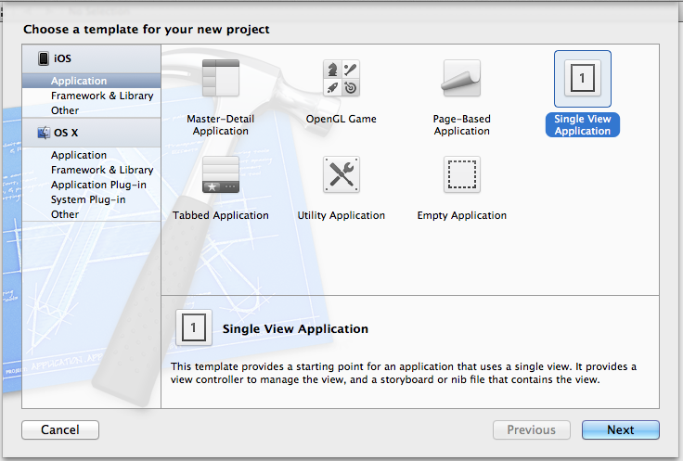
Create a new Single View Application

Slide 52
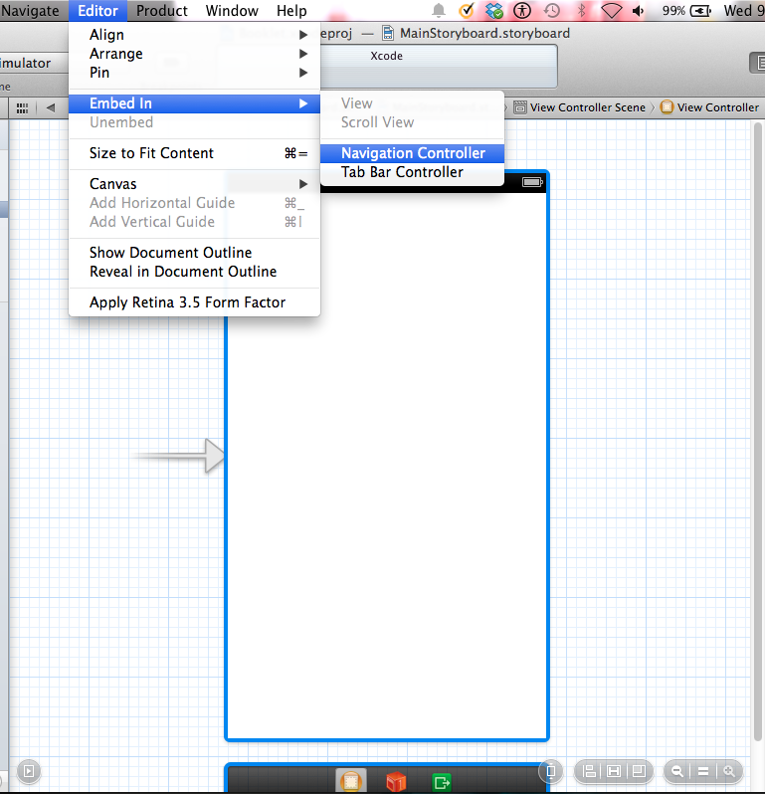
Change the View Controller to a Navigation Controller
Notes:
Select the View Controller in Storyboard View then select Editor on the menu and select Embed In. Select Navigation controller

Slide 53
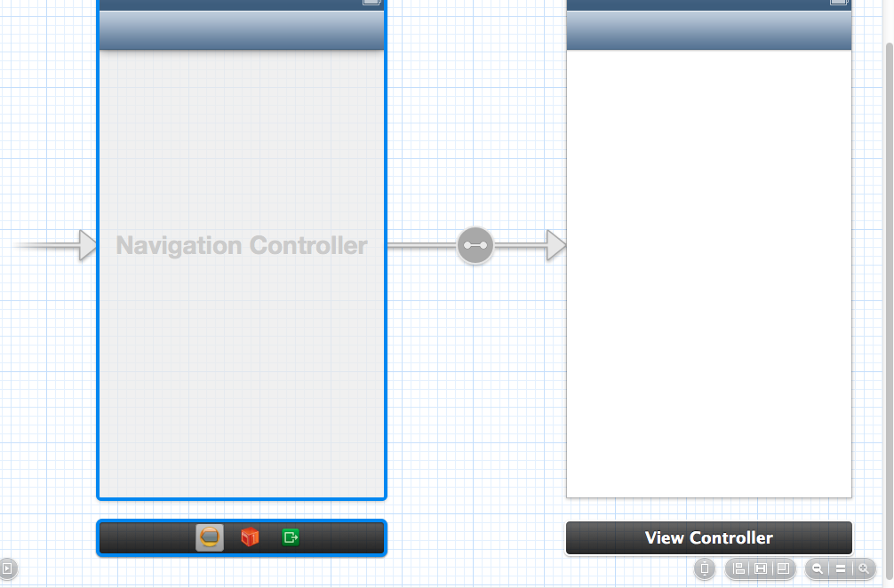
After Embedding…
Notes:
This is how your Storyboard view will look like after embedding

Slide 54
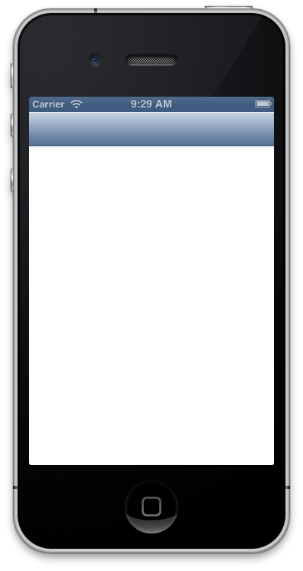
Run the App
Notes:
We won’t see much except an empty view controller

Slide 55
Adding Table View and Data

Slide 56
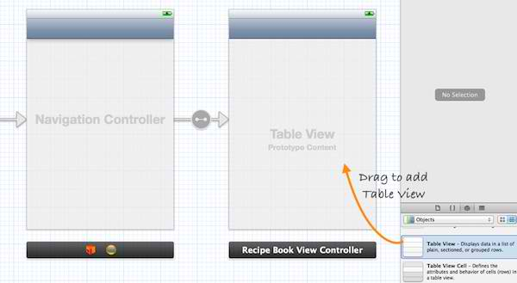
Add Table View

Slide 57
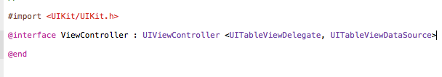
Modify ViewController.h
Notes:
Code:
//
// ViewController.h
// Booklet
//
// Created by Ronald Ramos on 10/30/13.
// Copyright (c) 2013 Ronald Ramos. All rights reserved.
//
#import <UIKit/UIKit.h>
@interface ViewController : UIViewController <UITableViewDelegate, UITableViewDataSource>
@end

Slide 58
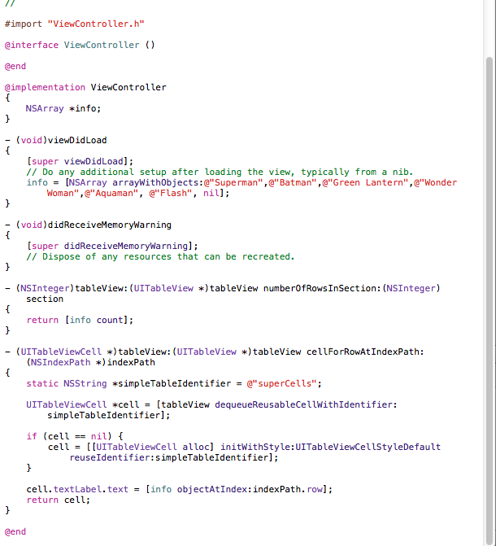
Modify ViewController.m
Notes:
Code:
#import "ViewController.h"
@interface ViewController ()
@end
@implementation ViewController
{
NSArray *info;
}
- (void)viewDidLoad
{
[super viewDidLoad];
// Do any additional setup after loading the view, typically from a nib.
info = [NSArray arrayWithObjects:@"Superman",@"Batman",@"Green Lantern",@"Wonder Woman",@"Aquaman", @"Flash", nil];
}
- (void)didReceiveMemoryWarning
{
[super didReceiveMemoryWarning];
// Dispose of any resources that can be recreated.
}
- (NSInteger)tableView:(UITableView *)tableView numberOfRowsInSection:(NSInteger)section
{
return [info count];
}
- (UITableViewCell *)tableView:(UITableView *)tableView cellForRowAtIndexPath:(NSIndexPath *)indexPath
{
static NSString *simpleTableIdentifier = @"superCells";
UITableViewCell *cell = [tableView dequeueReusableCellWithIdentifier:simpleTableIdentifier];
if (cell == nil) {
cell = [[UITableViewCell alloc] initWithStyle:UITableViewCellStyleDefault reuseIdentifier:simpleTableIdentifier];
}
cell.textLabel.text = [info objectAtIndex:indexPath.row];
return cell;
}
@end

Slide 59
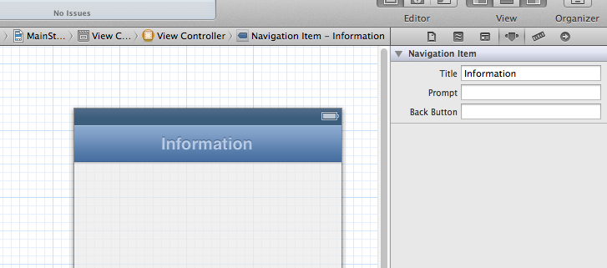
Give the Navigation Bar a name
Click Here
Change the property here

Slide 60
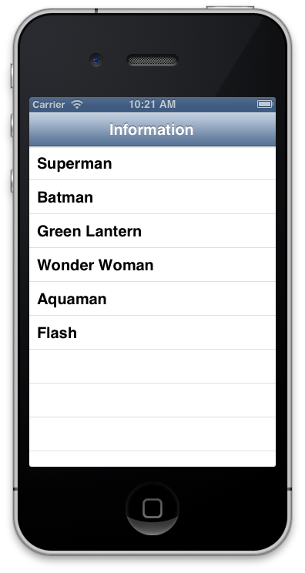
Run the App

Slide 61
Create the Protoype Cell

Slide 62
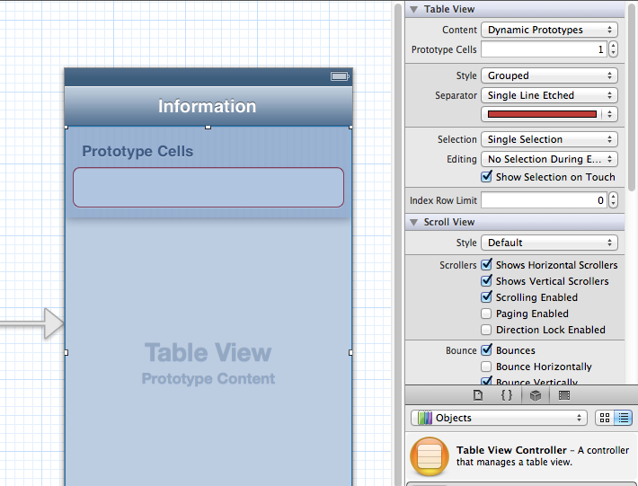
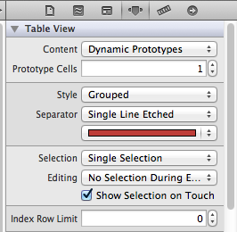
Enable Prototype Cell
Notes:
Select the table view and then change the property values as shown in the slide

Slide 63
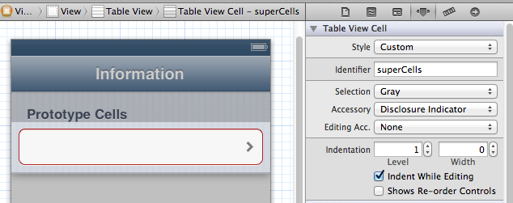
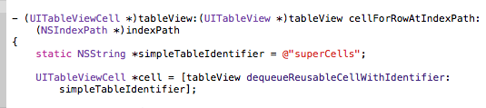
Modify the Prototype Cell properties
Identifier property matches value in code
Select the prototype cell
Code from ViewController.m
Notes:
Next, select the “Prototype Cell”. You should be able to customize the options of the cell. To display a disclosure indication for each cell, change the “Accessory” to “Disclosure Indicator”. It’s important to define the Reuse identifier. You can think of this identifier as the cell’s ID. We can use it to refer to a particular prototype cell. Here, we define the identifier as “RecipeCell” that matches with our code.

Slide 64
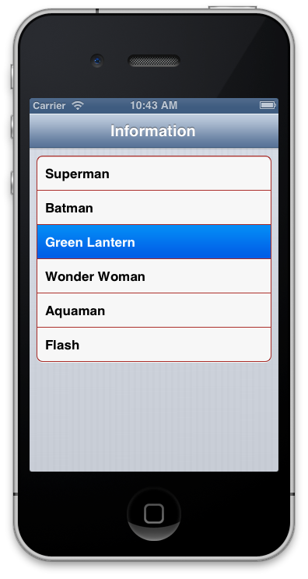
Run the App

Slide 65
Adding the Detail View

Slide 66
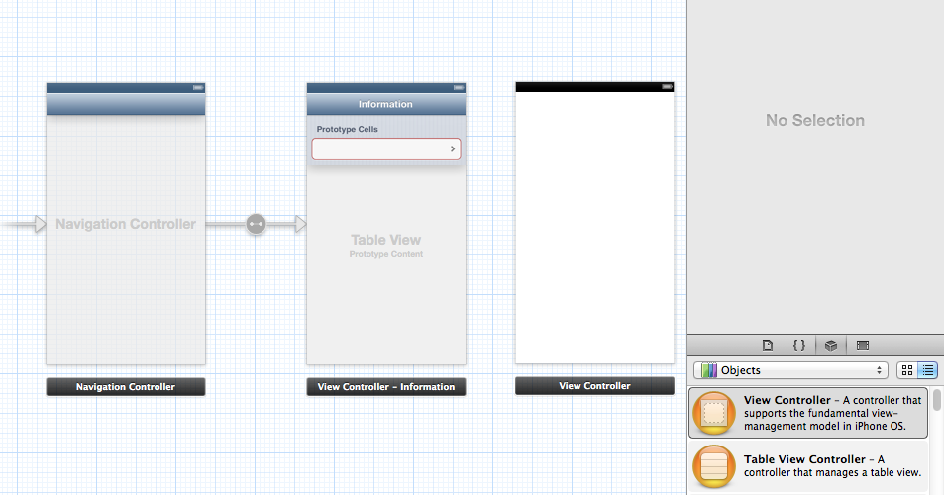
Add a View Controller to your Storyboard

Slide 67
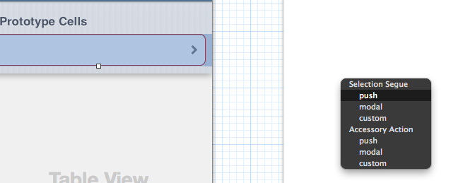
Add a Segue to the new ViewController
Control+Drag the Prototype Cell to the new ViewController.
Select Push as the Segue

Slide 68
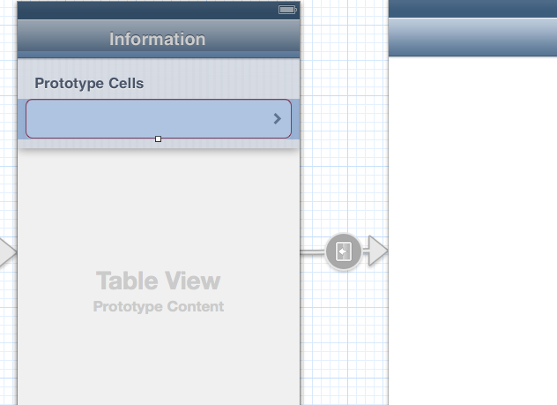
Segue from Main View Controller to New View Controller

Slide 69

The storyboard so far

Slide 70


Running the app

Slide 71
Passing data from one view to another

Slide 72
Adding a custom ViewController
Notes:
You need to add this to be able to make use of the second view controller.

Slide 73

Add a new file to your project
Notes:
Right click on the folder for your project and select new file

Slide 74

Select Objective-C class
Notes:
Choose Cocoa touch and then Objective-C Class

Slide 75

Give the class a name
Notes:
Make sure you select UIViewController as the “Subclass of” value

Slide 76

Save it to the project folder

Slide 77

New class appears

Slide 78

Associate new class with the second viewcontroller
Notes:
Select the second view controller (take note of the blue highlight around the screen. Go to the class inspector and the drop down list should have “DetailViewController”. Select that

Slide 79
Adding variables to the custom class
Notes:
We’ve just created our custom view controller class by extending from the UIViewController class. However, it doesn’t differ from the parent class until we add our own variables and methods. There are a couple of things we have to change:
Assign a variable (recipeName) for data passing – when user selects a hero in the table view, there must be a way to pass the name of hero to the detail view.
Assign a variable (recipeLabel) for the text label – presently the label is static. It should be updated as the name of hero changes.

Slide 80

DetailViewController.h
Notes:
Okay, let’s add these two variables (heroLabel and heroName). Select the “DetailViewController.h” and adds two properties for the interface.
CODE:
//
// DetailViewController.h
// Booklet
//
// Created by Ronald Ramos on 11/11/13.
// Copyright (c) 2013 Ronald Ramos. All rights reserved.
//
#import <UIKit/UIKit.h>
@interface DetailViewController : UIViewController
@property (nonatomic, strong) IBOutlet UILabel *heroLabel;
@property (nonatomic, strong) NSString *heroName;
@end

Slide 81

DetailViewController.m
Notes:
CODE:
//
// DetailViewController.m
// Booklet
//
// Created by Ronald Ramos on 11/11/13.
// Copyright (c) 2013 Ronald Ramos. All rights reserved.
//
#import "DetailViewController.h"
@interface DetailViewController ()
@end
@implementation DetailViewController
@synthesize heroLabel;
@synthesize heroName;
- (id)initWithNibName:(NSString *)nibNameOrNil bundle:(NSBundle *)nibBundleOrNil
{
self = [super initWithNibName:nibNameOrNil bundle:nibBundleOrNil];
if (self) {
// Custom initialization
}
return self;
}
- (void)viewDidLoad
{
[super viewDidLoad];
// Do any additional setup after loading the view.
heroLabel.text = heroName;
}
- (void)didReceiveMemoryWarning
{
[super didReceiveMemoryWarning];
// Dispose of any resources that can be recreated.
}
@end

Slide 82

Adding a connection between the label and the variable
Control-Drag the view controller to the label

Slide 83

Adding a connection between the label and the variable
When you release the mouse you should see the variable appear on the list as shown in the picture.
Select the variable

Slide 84

Add code to DetailViewController.m
Notes:
CODE:
//
// DetailViewController.m
// Booklet
//
// Created by Ronald Ramos on 11/11/13.
// Copyright (c) 2013 Ronald Ramos. All rights reserved.
//
#import "DetailViewController.h"
@interface DetailViewController ()
@end
@implementation DetailViewController
@synthesize heroLabel;
@synthesize heroName;
- (id)initWithNibName:(NSString *)nibNameOrNil bundle:(NSBundle *)nibBundleOrNil
{
self = [super initWithNibName:nibNameOrNil bundle:nibBundleOrNil];
if (self) {
// Custom initialization
}
return self;
}
- (void)viewDidLoad
{
[super viewDidLoad];
// Do any additional setup after loading the view.
heroLabel.text = heroName;
}
- (void)didReceiveMemoryWarning
{
[super didReceiveMemoryWarning];
// Dispose of any resources that can be recreated.
}
@end

Slide 85


Run the App
Notes:
Observe that the detail window is now blank!

Slide 86
Passing Data Using Segue
Notes:
Segues manages the transition between view controllers. On top of this, segue objects are used to prepare for the transition from one view controller to another. When a segue is triggered, before the visual transition occurs, the storyboard runtime invokes prepareForSegue:sender: method of the current view controller (in our example, it’s the RecipeBookViewController). By implementing this method, we can pass any needed data to the view controller that is about to be displayed.
However, the best practice is to give each segue in your Storyboards an unique identifier. This identifier is a string that your application uses to distinguish one segue from another. As your app becomes more complex, it’s likely you’ll have more than one segue in the view controllers.

Slide 87

Name your Segue
Type the name for the Segue
Select the Segue!
Notes:
However, the best practice is to give each segue in your Storyboards an unique identifier. This identifier is a string that your application uses to distinguish one segue from another. As your app becomes more complex, it’s likely you’ll have more than one segue in the view controllers.
To assign the identifier, select the segue and set it in the identity inspector.

Slide 88


Add code to ViewController.m
Notes:
CODE added to ViewController.m:
- (void)prepareForSegue:(UIStoryboardSegue *)segue sender:(id)sender {
if ([segue.identifier isEqualToString:@"showHeroDetail"]) {
NSIndexPath *indexPath = [self.tableView indexPathForSelectedRow];
DetailViewController *destViewController = segue.destinationViewController;
destViewController.heroName = [info objectAtIndex:indexPath.row];
}
}
The prepareForSegue method will be called when the transition begins. The 1st line is used to verify the identifier of segue. In this case, the identifier is “showHeroDetail”. The 2nd line of code invokes the tableView:indexPathForSelectedRow to retrieve the selected table row. Once we have the selected row, we’ll pass it to the DetailViewController. A Segue object contains the view controller whose contents should be displayed at the end of the segue. You can always use “segue.destinationViewController” to retrieve the destination controller. In this case, the destination controller is the DetailViewController. The rest of the code is to pass the recipe name to the destination controller.
You can’t run your app right now. After you copy & paste the above method into RecipeBookViewController.m, you should see a number of errors.
There are three errors as shown above. But we can summarize them into two:
The property “tableView” is not found in DetailViewController.
What’s DetailViewController? Xcode doesn’t know what it is.

Slide 89


Fixing Errors #1
ViewController.h
Viewcontroller.m

Slide 90

Connect the ViewController to the tableView variable
Control-Drag
The
ViewController
Notes:
Control drag the ViewController to the table view

Slide 91

Fixing Error #2 and #3
Notes:
Add an import to ViewController.m to fix errors 2 and 3
In ViewController, it has no idea about DetailViewController. In Objective C, you use the “#import” directive to import the header file of other class. By importing the header file of “DetailViewController”, ViewController can access the properties and methods of the detail view controller. Place the following code at the very beginning to fix the error

Slide 92


Run the App

Slide 93
Pat yourself on the back! You are done!

