Slide 1



iOS App Development
Day 1

Slide 2







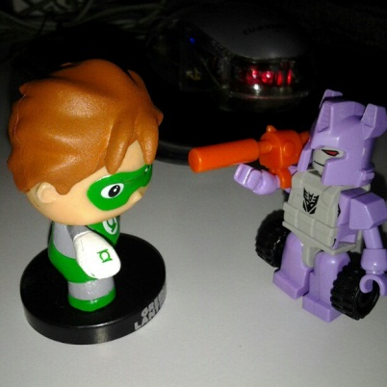
Ronald L. Ramos, PCD, Technology Group

Slide 3
Ronald L. Ramos (Contact information)
Mobile: 09298874076
Email: rlramos@smart.com.ph
Facebook: rlramos@gmail.com
Twitter: Taleweaver
My Lego Blog: brickstories.blogspot.com

Slide 4
Your Intro
Name/Nickname
Year/Course
Why are you here?
What are your expectations?
Favorite TV show/Movie? Why?

Slide 5
Setting Up

Slide 6
What you need to Develop
Mac
Xcode
Free Developer Account

Slide 7
What you need to test/deploy/distibute
iPhone/iPad
Paid Developer account ($99/year)

Slide 8
Objective-C

Slide 9
Objectives
Become familiar with Objective-C
Learn the basics of Objective-C
Learn to use the Xcode IDE
Gain an understanding of IOS development

Slide 10
Overview

Slide 11
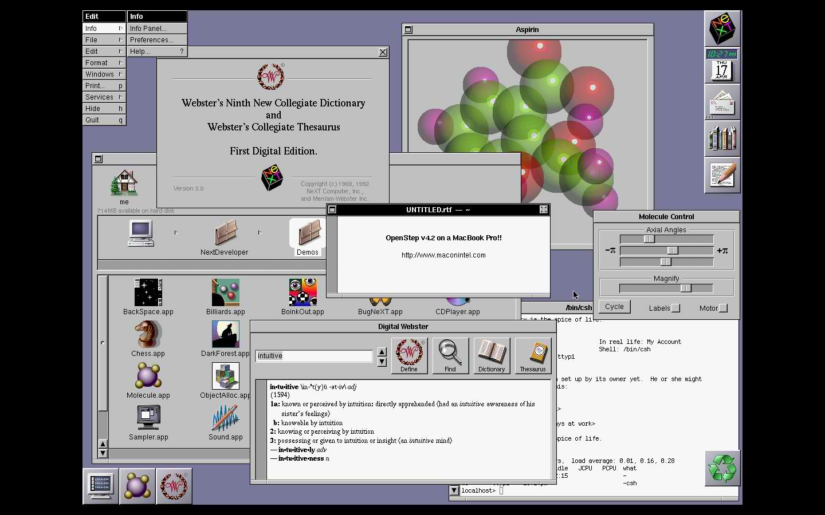
What is Objective-C?
Objective-C is an object oriented language which lies on top of the C language. Itʼs primary use in modern computing is on Mac OS X as a desktop language and on iOS.
It was originally the main language for NeXTSTEP OS, also known as the operating system Apple bought and descended Mac OS X from..
Objective-C is a strict superset of C, we are free to use C in an Objective-C file and it will compile fine.
Notes:
Because any compiler of Objective-C will also compile any straight C code passed into it, we have all the power of C along with the power of objects provided by Objective-C.

Slide 12
What you’ll need
A Mac computer with the latest version of Mac OsX (A Mac Mini or MacBook Air would do fine)
The latest Xcode (free download from AppStore)

Slide 13
The Basics

Slide 14
Creating an Xcode project
Open Xcode
Select “Create an Application”
Select ”OS X” applicaton of type “Console Application”
Give the project a name, organization value and company identifier
To create a pure C application pick type C, for an Objective C application pick “Foundation” as its type click next
Xcode will now generate your project

Slide 15
The basic C application
#include <stdio.h>
  int main(){
  printf("Hello World\n");
  return 0;
}
Notes:
Objective-C itself isnʼt that hard to learn. Once you get to grips with the basic principles, you can pick the rest up as you go along pretty easily. You do need to have an understanding of the fundamentals of C programming though, and that is what the rest of this tutorial will cover.
Letʼs look at a basic application in main.c:
#include <stdio.h>
int main(){
printf("Hello World\n");
return 0;
}
All this application will do when you run it is display the string “Hello World” in Terminal and exit.
NOTE:
Curious about the “return 0″ statement? Because we told the compiler that the function main() will return an integer, we return the constant integer value ’0′ at the end of the function. By convention, returning ’0′ signals to the calling program that our program finished execution without any errors.
To try this for yourself, fire up Xcode and make a new Objective-C class. Delete all the code Xcode gives you by default and stick the above code in. Once youʼve done that, you can compile it using Terminal.
Create a project that uses C as the core

Slide 16
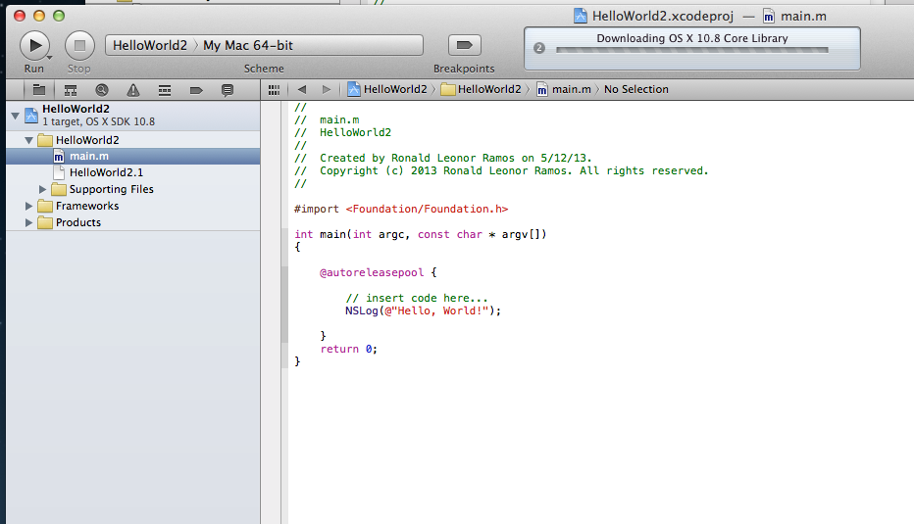
Hello World in Objective-C
Notes:
When you create the project make sure that the core is “Foundation”
Main.m is created instead of main.c:
//
// main.m
// HelloWorld2
//
// Created by Ronald Leonor Ramos on 5/12/13.
// Copyright (c) 2013 Ronald Leonor Ramos. All rights reserved.
//
#import <Foundation/Foundation.h>
int main(int argc, const char * argv[])
{
@autoreleasepool {
// insert code here...
NSLog(@"Hello, World!");
}
return 0;
}

Slide 17
The main() Function
As with plain old C programs, the main() function serves as the root of an Objective-C application.
Notes:
The main() Function
As with plain old C programs, the main() function serves as the root of an Objective-C application. Most of the built-in Xcode templates create a file called main.m that defines a default main() function. Selecting our main.m in Xcode’s Project Navigator panel should open the editor window and display the following.
#import <Foundation/Foundation.h>
int main(int argc, const char * argv[]) {
@autoreleasepool {
// insert code here...
NSLog(@"Hello, World!");
}
return 0;
}
Inside of the @autoreleasepool block is where you can write code and experiment with the language. The above main() function simply calls the global NSLog() function defined by the Foundation Framework. This is Objective-C’s general-purpose tool for outputting messages to the console. Also note that Objective-C strings are always prefixed with an at (@) symbol.

Slide 18
C Basics

Slide 19
Variables
Variables are containers that can store different values. In C, variables are statically typed, which means that you must explicitly state what kind of value they will hold.
To declare a variable, you use the <type> <name> syntax, and to assign a value to it you use the = operator. If you need to interpret a variable as a different type, you can cast it by prefixing it with the new type in parentheses.
Important data types:
  int – for storing integers (numbers with no decimal point)
  char – for storing a character
  float – for storing numbers with decimal points
  double – same as a float but double the accuracy

Slide 20
Variables sample code
// main.m
#import <Foundation/Foundation.h>
int main(int argc, const char * argv[]) {
@autoreleasepool {
double odometer = 9200.8;
int odometerAsInteger = (int)odometer;
NSLog(@"You've driven %.1f miles", odometer); // 9200.8
NSLog(@"You've driven %d miles", odometerAsInteger); // 9200
}
return 0;
}
Notes:
All of this is demonstrated in the following example. It declares a variable called odometer that stores a value of type double. The (int)odometer statement casts the value stored in odometer to an integer. If you paste this code into your main.m file in Xcode and run the program, you should see the NSLog() messages displayed in your Output panel.

Slide 21
Constants
The const variable modifier can be used to tell the compiler that a variable is never allowed to change. For example, defining a constant called pi and then trying to alter it will result in a compiler error:
double const pi = 3.14159;
pi = 42001.0; // Compiler error
This is often used in function parameters to inform the caller that they can safely assume whatever value they pass will not be altered by the function.

Slide 22
Arithmetic
The familiar +, -, *, / symbols are used for basic arithmetic operations, and the modulo operator (%) can be used to return the remainder of an integer division.
These are all demonstrated below:
NSLog(@"6 + 2 = %d", 6 + 2); // 8
NSLog(@"6 - 2 = %d", 6 - 2); // 4
NSLog(@"6 * 2 = %d", 6 * 2); // 12
NSLog(@"6 / 2 = %d", 6 / 2); // 3
NSLog(@"6 %% 2 = %d", 6 % 2); // 0
Notes:
Arithmetic
Special care must be taken when performing operations that involve both floating-point and integer types. Please see Integer Division for details.

Slide 23
Arithmetic
You’ll also frequently encounter the increment (++) and decrement (--) operators when working with loops. These are convenience operators for adding or subtracting 1 from a variable. For example:
int i = 0;
NSLog(@"%d", i); // 0
i++;
NSLog(@"%d", i); // 1
i++;
NSLog(@"%d", i); // 2

Slide 24
Conditionals
C provides the standard if statement found in most programming languages. Its syntax, along with a table describing the most common relational/logical operators, is shown below:
int modelYear = 1990;
if (modelYear < 1967) {
NSLog(@"That car is an antique!!!");
} else if (modelYear <= 1991) {
NSLog(@"That car is a classic!");
} else if (modelYear == 2013) {
NSLog(@"That's a brand new car!");
} else {
NSLog(@"There's nothing special about that car.");
}
Notes:
C provides the standard if statement found in most programming languages. Its syntax, along with a table describing the most common relational/logical operators, is shown below.
int modelYear = 1990;
if (modelYear < 1967) {
NSLog(@"That car is an antique!!!");
} else if (modelYear <= 1991) {
NSLog(@"That car is a classic!");
} else if (modelYear == 2013) {
NSLog(@"That's a brand new car!");
} else {
NSLog(@"There's nothing special about that car.");
}

Slide 25
Relational/Logical Operators
Operator | Description
== | Equal to
!= | Not equal to
> | Greater than
>= | Greater than or equal to
< | Less than
<= | Less than or equal to
! | Logical negation
&& | Logical and
|| | Logical or

Slide 26
Switch
// Switch statements (only work with integral types)
switch (modelYear) {
case 1987:
NSLog(@"Your car is from 1987.");
break;
case 1988:
NSLog(@"Your car is from 1988.");
break;
case 1989:
case 1990:
NSLog(@"Your car is from 1989 or 1990.");
break;
default:
NSLog(@"I have no idea when your car was made.");
break;
}
C also includes a switch statement, however it only works with integral types—not floating-point numbers, pointers, or Objective-C objects. This makes it rather inflexible when compared to the if conditionals discussed above.
Notes:
// Switch statements (only work with integral types)
switch (modelYear) {
case 1987:
NSLog(@"Your car is from 1987.");
break;
case 1988:
NSLog(@"Your car is from 1988.");
break;
case 1989:
case 1990:
NSLog(@"Your car is from 1989 or 1990.");
break;
default:
NSLog(@"I have no idea when your car was made.");
break;
}

Slide 27
Loops
For loops
While loops
int modelYear = 1990;
// While loops
int i = 0;
while (i<5) {
if (i == 3) {
NSLog(@"Aborting the while-loop");
break;
}
NSLog(@"Current year: %d", modelYear + i);
i++;
}
// For loops
for (int i=0; i<5; i++) {
if (i == 3) {
NSLog(@"Skipping a for-loop iteration");
continue;
}
NSLog(@"Current year: %d", modelYear + i);
}
Notes:
The while and for loops can be used for iterating over values, and the related break and continue keywords let you exit a loop prematurely or skip an iteration, respectively.

Slide 28
For-In
// For-in loops ("Fast-enumeration," specific to Objective-C)
NSArray *models = @[@"Ford", @"Honda", @"Nissan", @"Porsche"];
for (id model in models) {
NSLog(@"%@", model);
}
Notes:
While it’s technically not a part of the C programming language, this is an appropriate time to introduce the for-in loop. This is referred to as the fast-enumeration syntax because it’s a more efficient way to iterate over Objective-C collections like NSSet and NSArray than the traditional for and while loops.

Slide 29
Pointers
int foo = 123; // This is an integer variable
int *ptr = &foo; // This is a pointer to an integer variable
Notes:
Pointers point to a location. Specifically, locations in computer memory. Think of it like this, when we create a variable (let's say it's an integer called ʻfooʼ as is so popular with programming theory) and give it a value of, for example 123, we have just that - a variable with a value of 123. Now, if we setup a pointer to foo, then we have a way of indirectly accessing it. That is, we have a pointer of type int that points to foo which holds the value '123.'

Slide 30
Hello Objective-C

Slide 31
Why Objective-C?
Like C++, Objective-C was designed to add object-oriented features to C, but the two languages accomplished this using fundamentally distinct philosophies.
Objective-C is decidedly more dynamic, deferring most of its decisions to run-time rather than compile-time. This is reflected in many of the design patterns underlying iOS and OS X development.

Slide 32
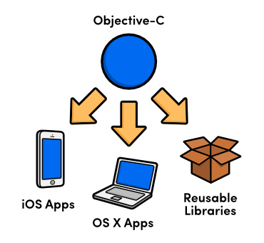
Types of programs written in Objective C

Slide 33
Object-Oriented Programming
OOP is a programming paradigm that attempts to allow developers to think about software design in terms of objects and attributes instead of variables and functions.
Specifically, OOP attempts to obtain:
  data abstraction,
  encapsulation,
  modularity,
  polymorphism, and
  inheritance.
Notes:
Imagine that you have a car. You can think of your car as an object. There are many other cars in the world and you might even own more than one. Your car has various properties to it: make, model, color, engine type, and many more. In Object Oriented Programming terms, we would call the abstract concept of a car a “class” and the individual car that you own an object or instance (instantiated object) of the class. When a new car is manufactured, a new instance of the car class is instantiated (or created) and given its own set of properties.
Still a little fuzzy? Another great analogy is that of the cookie and the cookie cutter. The class is the cookie cutter, and the object is the cookie.
So, why think in terms of objects? One of the best reasons is because this is how your brain naturally conceptualizes life in the real world, and there are many benefits to being able to abstract software development in similar terms.
Classes (and hence objects) are made up of methods and attributes. If you come from another programming language, you may be more familiar equating methods with functions and attributes with variables. We will discuss each in turn next.

Slide 34
Verbose naming
// C++
john->drive("Corvette", "Mary's House")
// Objective-C
[john driveCar:@"Corvette" toDestination:@"Mary's House"]
Notes:
Objective-C is also known for its verbose naming conventions. The resulting code is so descriptive that it’s virtually impossible to misunderstand or misuse it. For example, the following snippet shows a C++ method call with its Objective-C equivalent.

Slide 35
Frameworks
As with most programming languages, Objective-C is a relatively simple syntax backed by an extensive standard library. This tutorial focuses mostly on the language itself, but it helps to have at least some idea of the tools that you’ll be interacting with in the real world.
There are a few different “standard libraries” out there, but Apple’s Cocoa and Cocoa Touch frameworks are by far the most popular. These define the API for building OS X and iOS apps, respectively.

Slide 36
Interface and Implementation
Interface – car.h
Implementation – car.m
#import <cocoa cocoa.h="">
@interface Car : NSObject {
//This is where attributes go
float fillLevel;
}
//This is where methods go
- (void)addGas;
@end
</cocoa>
#import "Car.h"
@implementation Car
-(void) addGas {
// code goes here to add gas
}
@end
Notes:
When you create or work with a simple class in Objective-C you will see that it, by default, has two files. One is the implementation file which is a file that ends with a suffix of .m and the interface file which is a file that ends with a suffix of .h.
First of all, weʼre importing Cocoa.h which is a standard library with a lot of reusable code that we can use inside our app.
Next, weʼre declaring that this is the interface for the Car, but weʼre also putting NSObject into that declaration. Adding “: NSObject” means that the Car class inherits from the NSObject class. We’ll talk more about inheritance in a future tutorial.
Our instance variable “fillLevel” is declared next, and we specify that it is of the “float” data type so we can easily represent a percentage.
The next line declares our “addGas” method. The “-” indicates that this is an instance method, not a class method. The “(void)” portion means that the method will not return anything back when it finishes executing. If the class was going to return an integer, this would be changed to “(int)” and the same for any other data type. Finally, we finalize the method declaration with a semicolon.

Slide 37
Classes and Objects

Slide 38
Classes from Apple
NSString is a string of text that is immutable.
NSMutableString is a string of text that is mutable.
NSArray is an array of objects that is immutable.
NSMutableArray is an array of objects that is mutable.
NSNumber holds a numeric value.
NOTE: If an object is immutable that means when we create the object and assign a value then it is static. The value can not be changed. If an object is mutable then it is dynamic, meaning the value can be changed after creation.
Notes:
Many classes Apple provides are prepended by the abbreviation “NS”, which stands for NextStep. When Steve Jobs left Apple, he founded NeXT, creating workstation computers that ran on its operating system. The object orientated programming language used on those machines was called NeXTSTEP, which is where we get the “NS” from. When Apple ʻacquiredʼ (another history lesson in itself) NeXTSTEP, they decided to base Mac OS X on NeXTSTEP.

Slide 39
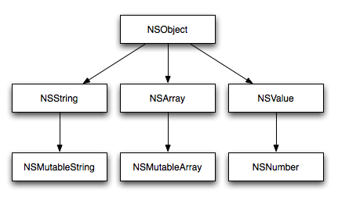
Inheritance
Notes:
Remember when we made our NSString earlier, we used the init method? Well NSMutableString, NSArray and in fact, every single NS class, also uses init. Seems a lot of wasted code to put the init method in each class, right? It would be, thatʼs why init is usually only implemented once, in the root class known as NSObject. Because classes inherit from each other, a class that is created as a child of another, parent class will automatically gain access to the parent class methods.
Letʼs take NSMutableString for example. NSMutableString has NSString for a parent (making it a child), meaning it inherits from NSString. Meanwhile. NSString has NSObject as a parent, so it inherits from NSObject.
So for example, NSObject has a method called init, so each subclass has this method implemented – which is called a class method. As a matter of fact, the init method in NSObject doesn’t actually do anything it simply returns self. The reason for this is that methods can be overwritten. So the NSArray class may override the init that it inherits to add functionality to it – such as making sure memory is available or preparing any instance variables it may need.
As demonstrated, this is useful because it means that in addition to inheriting from classes we can also extend classes. When we extend a class, we take an existing class and add additional functionality to what is already available. This means you could create your own version of NSString with additional methods, such as a method to fill the string with random text or perform some sort of character encoding.

Slide 40
iOS apps

Slide 41
Three Ts
Tools
Technologies
Techniques

Slide 42
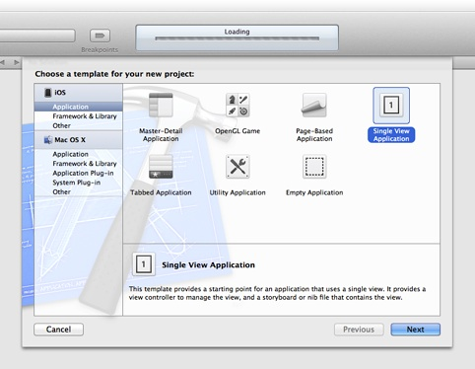
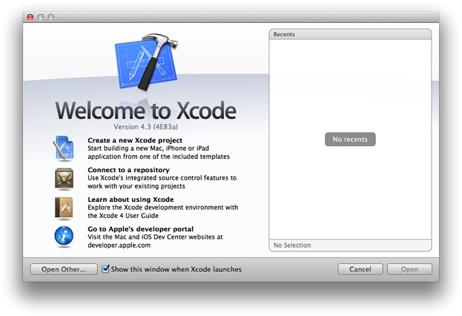
Create a new project!
1. Open Xcode
2. Pick “Single View Application”
Notes:
In the Welcome to Xcode window, click “Create a new Xcode project” (or choose File > New > Project).
Xcode opens a new window and displays a dialog in which you can choose a template. Xcode includes several built-in app templates that you can use to develop common styles of iOS apps. For example, the Tabbed template creates an app that is similar to iTunes and the Master-Detail template creates an app that is similar to Mail.
In the Welcome to Xcode window, click “Create a new Xcode project” (or choose File > New > Project).
Xcode opens a new window and displays a dialog in which you can choose a template. Xcode includes several built-in app templates that you can use to develop common styles of iOS apps. For example, the Tabbed template creates an app that is similar to iTunes and the Master-Detail template creates an app that is similar to Mail.
In the iOS section at the left side of the dialog, select Application.
In the main area of the dialog, select Single View Application and then click Next.
A new dialog appears that prompts you to name your app and choose additional options for your project.

Slide 43
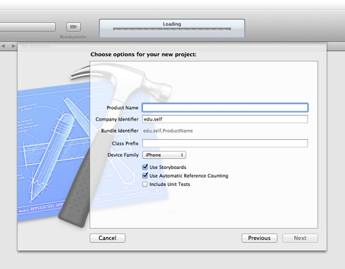
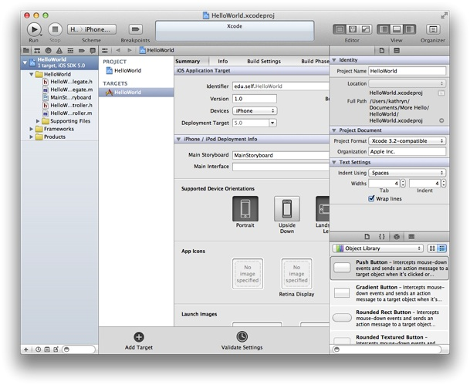
Create a new project!
3.
4.

Slide 44
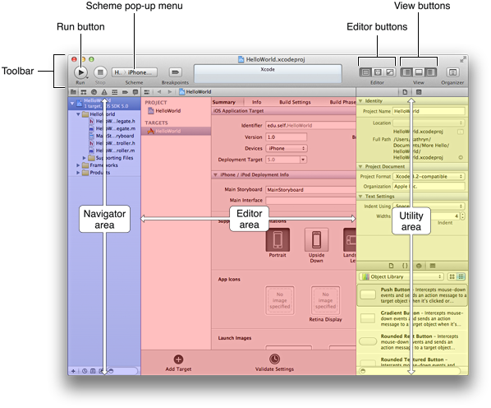
Xcode’s Workspace Window

Slide 45
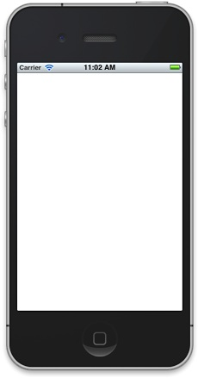
Running the default app
Notes:
Even though you haven’t yet written any code, you can build your app and run it in the Simulator app that is included in Xcode. As its name implies, Simulator allows you to get an idea of how your app would look and behave if it were running on an iOS-based device.
After Xcode finishes building your project, Simulator should start automatically (you might have to wait a few seconds for Simulator to appear on top of the workspace window). Because you specified an iPhone product (rather than an iPad product), Simulator displays a window that looks like an iPhone. On the simulated iPhone screen, Simulator opens your app, which should look like the picture above.
Right now, your app is not very interesting: it simply displays a blank white screen. To understand where the white screen comes from, you need to learn about the objects in your code and how they work together to start the app. For now, quit Simulator (choose iOS Simulator > Quit iOS Simulator; make sure that you don’t quit Xcode).
To close the Debug area
Click the Debug View button in the toolbar.
The Debug View button is the middle View button and it looks like this:

Slide 46
The Debug Window
Close the Debug Area
Click the Debug View button in the toolbar.
The Debug View button is the middle View button and it looks like this:
Notes:
When you run your app, Xcode might open the Debug area at the bottom of the workspace window.
You can close it to make more room in your window.

Slide 47
Some Basics

Slide 48
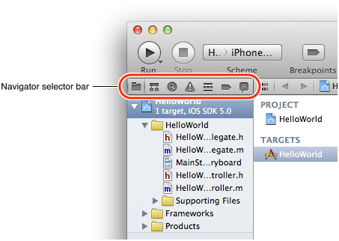
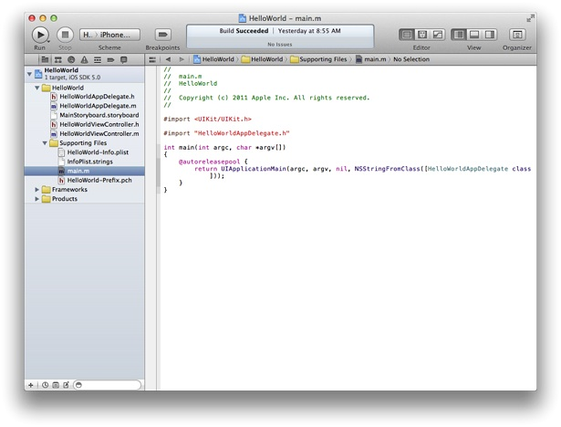
main.m
To look at main.m
Notes:
Open the Supporting Files folder in the project navigator by clicking the disclosure triangle next to it.
Select main.m. Xcode opens the source file in the main editor area of the window

Slide 49
Main function in main.m
@autoreleasepool {
return UIApplicationMain(argc, argv, nil, NSStringFromClass([HelloWorldAppDelegate class]));
}
Notes:
The @autoreleasepool statement supports the Automatic Reference Counting (ARC) system. ARC provides automatic object-lifetime management for your app, ensuring that objects remain in existence for as long as they're needed and no longer.
The call to UIApplicationMain creates an instance of the UIApplication class and an instance of the app delegate (in this tutorial, the app delegate is HelloWorldAppDelegate, which is provided for you by the Single View template). The main job of the app delegate is to provide the window into which your app’s content is drawn. The app delegate can also perform some app configuration tasks before the app is displayed. (Delegation is a design pattern in which one object acts on behalf of, or in coordination with, another object.)
In an iOS app, a window object provides a container for the app’s visible content, helps deliver events to app objects, and helps the app respond to changes in the device’s orientation. The window itself is invisible.
The call to UIApplicationMain also scans the app’s Info.plist file.

Slide 50
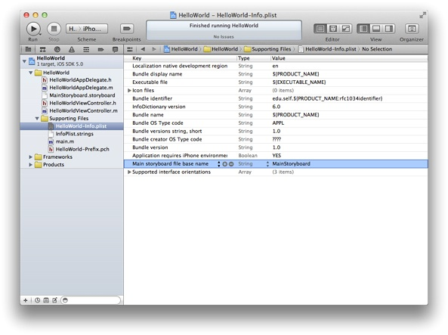
Info.plist
Notes:
The Info.plist file is a property list (that is, a structured list of key-value pairs) that contains information about the app such as its name and icon.
Because you chose to use a storyboard in this project, the Info.plist file also contains the name of the storyboard file that the application object should load. A storyboard contains an archive of the objects, transitions, and connections that define an app’s user interface.
In the HelloWorld app, the storyboard file is named MainStoryboard.storyboard (note that the Info.plist file shows only the first part of this name). When the app starts, MainStoryboard.storyboard is loaded and the initial view controller is instantiated from it. A view controller is an object that manages an area of content; theinitial view controller is simply the first view controller that gets loaded when an app starts.
The HelloWorld app contains only one view controller (specifically, HelloWorldViewController). Right now,HelloWorldViewController manages an area of content that is provided by a single view. A view is an object that draws content in a rectangular area of the screen and handles events caused by the user’s touches. A view can also contain other views, which are called subviews. When you add a subview to a view, the containing view is called the parent view and its subview is called a child view. The parent view, its child views (and their child views, if any) form a view hierarchy. A view controller manages a single view hierarchy.

Slide 51
A short note about MVC
The views and the view controller in your iOS app represent two of the three roles for app objects that are defined by the design pattern called Model-View-Controller (MVC).
The third role is the model object. In MVC, model objects represent data (such as a to-do item in a calendar app or a shape in a drawing app), view objects know how to display the data represented by model objects, and controller objects mediate between models and views.
In an iOS app, the model object is the string that holds the name that the user enters.
Notes:
You don’t need to know more about MVC right now, but it’s a good idea to begin thinking about how the objects in your app play these different roles.

Slide 52
Modifying your storyboard

Slide 53
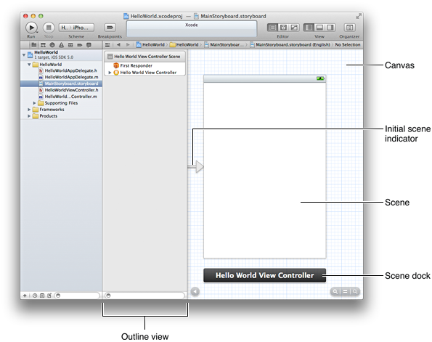
The Storyboard
Notes:
You can see visual representations of the view controller and its view in the storyboard.
To look at the storyboard
Select MainStoryboard.storyboard in the project navigator.
Xcode opens the storyboard in the editor area. (The area behind the storyboard objects—that is, the area that looks like graph paper—is called the canvas.)
The area below the scene on the canvas is called the scene dock. Right now, the scene dock displays the view controller’s name (that is, Hello World View Controller). At other times, the scene dock can contain the icons that represent the first responder and the view controller object.

Slide 54
What is a storyboard?
A storyboard contains scenes and segues. A scene represents a view controller, and a segue represents a transition between two scenes.
Because the Single View template provides one view controller, the storyboard in your app contains one scene and no segues. The arrow that points to the left side of the scene on the canvas is the initial scene indicator, which identifies the scene that should be loaded first when the app starts (typically, the initial scene is the same as the initial view controller).
The scene that you see on the canvas is named Hello World View Controller because it is managed by theHelloWorldViewController object. The Hello World View Controller scene consists of a few items that are displayed in the Xcode outline view (which is the pane that appears between the canvas and the project navigator).

Slide 55
Parts of the View controller
A first responder placeholder object (represented by an orange cube).
The first responder is a dynamic placeholder that represents the object that should be the first to receive various events while the app is running. These events include editing-focus events (such as tapping a text field to bring up the keyboard), motion events (such as shaking the device), and action messages (such as the message a button sends when the user taps it), among others. You won’t be doing anything with the first responder in this tutorial.
The HelloWorldViewController object (represented by a pale rectangle inside a yellow sphere).
When a storyboard loads a scene, it creates an instance of the view controller class that manages the scene.
A view, which is listed below the view controller (to reveal this view in the outline view, you might have to open the disclosure triangle next to Hello World View Controller).
The white background of this view is what you saw when you ran the app in Simulator.

Slide 56
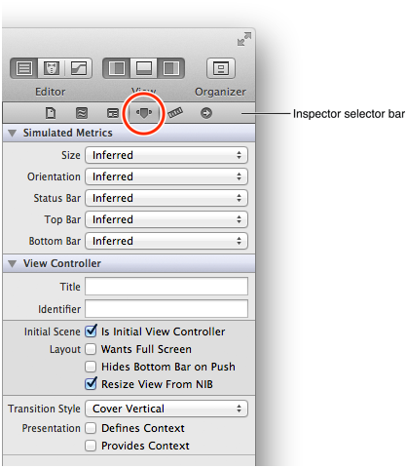
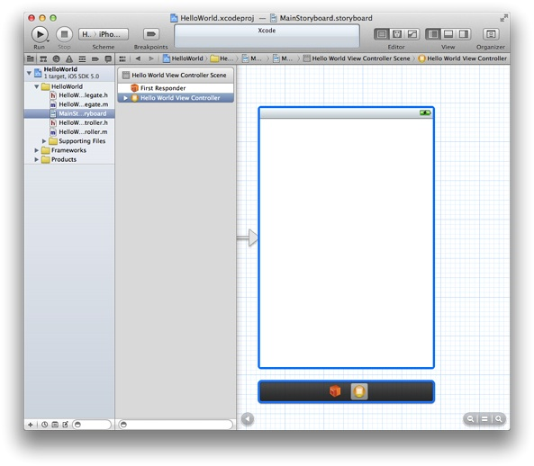
The Inspector
The storyboard selected
Attributes inspector
Notes:
The @autoreleasepool statement supports the Automatic Reference Counting (ARC) system. ARC provides automatic object-lifetime management for your app, ensuring that objects remain in existence for as long as they're needed and no longer.
The call to UIApplicationMain creates an instance of the UIApplication class and an instance of the app delegate (in this tutorial, the app delegate is HelloWorldAppDelegate, which is provided for you by the Single View template). The main job of the app delegate is to provide the window into which your app’s content is drawn. The app delegate can also perform some app configuration tasks before the app is displayed. (Delegation is a design pattern in which one object acts on behalf of, or in coordination with, another object.)
In an iOS app, a window object provides a container for the app’s visible content, helps deliver events to app objects, and helps the app respond to changes in the device’s orientation. The window itself is invisible.
The call to UIApplicationMain also scans the app’s When an app starts up, the main storyboard file is loaded and the initial view controller is instantiated. The initial view controller manages the first scene that users see when they open the app. Because the Single View template provides only one view controller, it’s automatically set to be the initial view controller. You can verify the status of the view controller, and find out other things about it, by using the Xcode inspector.
bullet
To open the inspector
If necessary, click MainStoryboard.storyboard in the project navigator to display the scene on the canvas.
In the outline view, select Hello World View Controller (it’s listed below First Responder). Your workspace should look like the picture on the left. Notice that the scene and the scene dock are both outlined in blue, and the view controller object is selected in the scene dock.
Click the rightmost View button in the toolbar to display the utilities area at the right side of the window (or choose View > Utilities > Show Utilities).
Click the Attributes inspector button in the utilities area to open the Attributes inspector. The Attributes inspector button is the fourth button from the left in the inspector selector bar at the top of the utilities area:

Slide 57
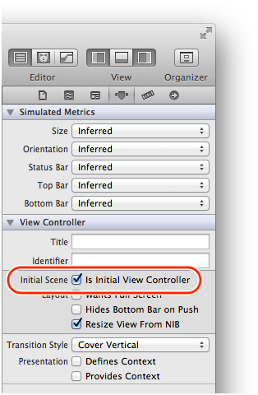
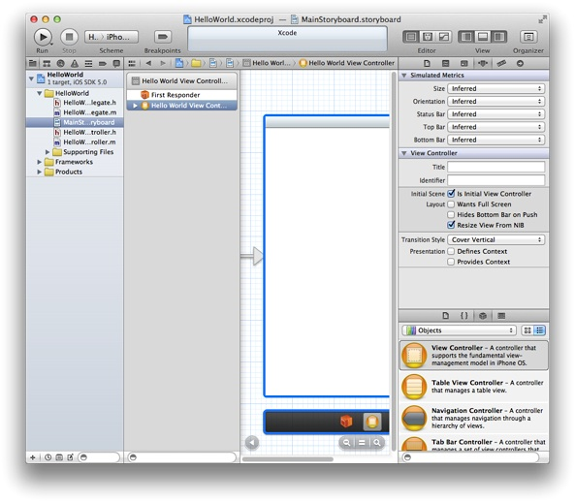
Open Attributes inspector
Notes:
With the Attributes inspector open, your workspace window should look something like the picture on the left (you might have to resize the window to see everything)
In the View Controller section of the Attributes inspector, you can see that the Initial Scene option is selected. Note that if you deselect this option, the initial scene indicator disappears from the canvas. For this tutorial, make sure the Initial Scene option remains selected.

Slide 58
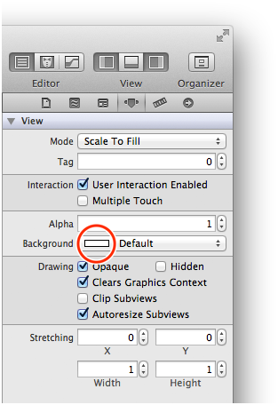
Changing the View’s Background Color
In the outline view, click the disclosure triangle next to Hello World View Controller (if it’s not already open) and select View.
Xcode highlights the view area on the canvas.
Click the Attributes button in the inspector selector bar at the top of the utilities area to open the Attributes inspector, if it’s not already open.
In the Attributes inspector, click the white rectangle in the Background pop-up menu to open the Colors window.
The rectangle displays the current color of the item’s background. The Background pop-up menu looks like this:
Notes:
A view provides the white background that you saw when you ran the app in Simulator. To make sure that your app is working correctly, you can set the background color of the view to something other than white and verify that the new color is displayed by again running the app in Simulator.
Before you change the background of the view, make sure that the storyboard is still open on the canvas. (If necessary, click MainStoryboard.storyboard in the project navigator to open the storyboard on the canvas.)

Slide 59
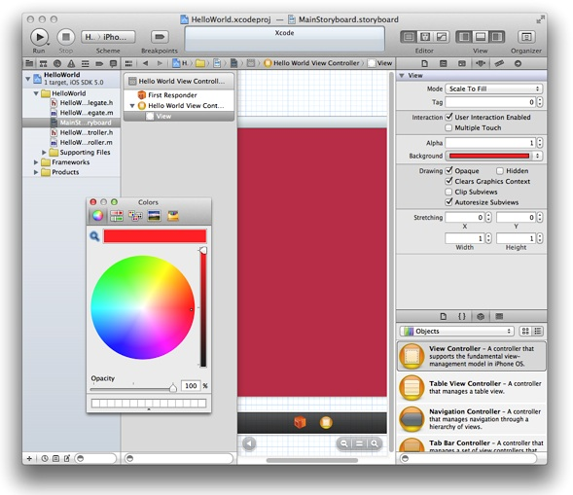
Choosing a color

Slide 60
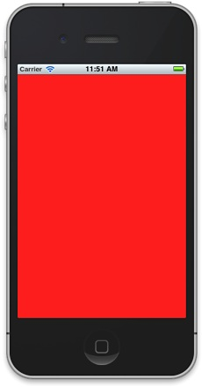
Running the app again
Notes:
Click the Run button (or choose Product > Run) to test your app in Simulator. Make sure the Scheme pop-up menu in the Xcode toolbar still displays HelloWorld > iPhone 6.0 Simulator
Restoring the background color:
In the Attributes inspector, open the Background pop-up menu by clicking the arrows.
Note that the rectangle in the Background pop-up menu has changed to display the color you chose in the Colors window. If you click the colored rectangle (instead of the arrows), the Colors window reopens. Because you want to reuse the view’s original background color, it’s easier to choose it from the Background menu than it is to find it in the Colors window.
In the Background pop-up menu, choose the white square listed in the Recently Used Colors section of the menu.
Click the Run button to compile and run your app (and to save your changes).
After you’ve verified that your app again displays a white background, quit Simulator.

Slide 61
Buttons!

Slide 62
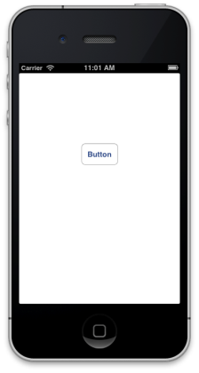
Create a new project
Notes:
We will create a new project with one button. Before the end of class we will make the button work.

Slide 63
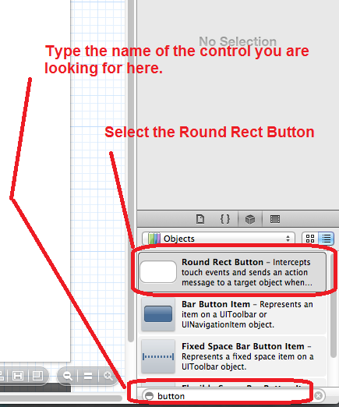
Search for Round Rect Button
Notes:
It is easier to look for controls by typing their name in the search box.

Slide 64
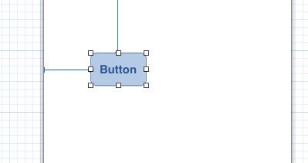
Drag Button to the Storyboard
Notes:
Drag the button to your storyboard. When selected guidelines will also appear to show you the positioning of the control on the storyboard

Slide 65
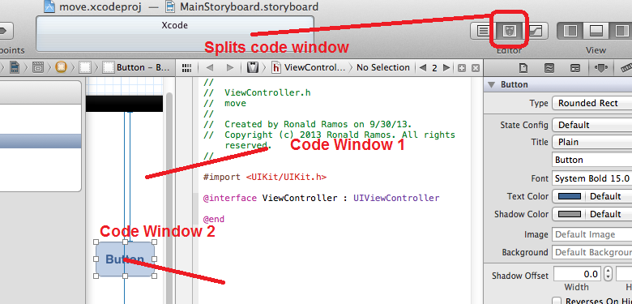
Click on the middle Editor button
Notes:
When working with code it is easier if you split the code window so it can show both the Storyboard and code on different panes.

Slide 66
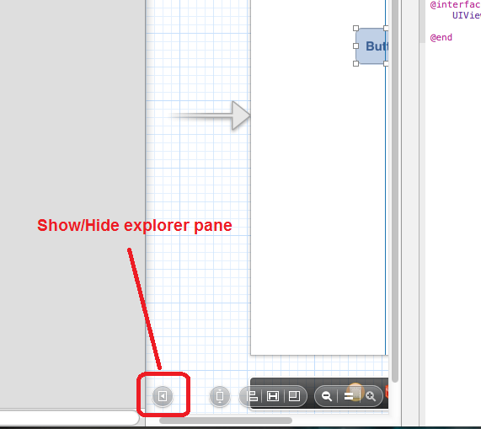
Get more space
Notes:
You can hide/show the Explorer pane and get more space by clicking on one butotn

Slide 67
Making the button work

Slide 68
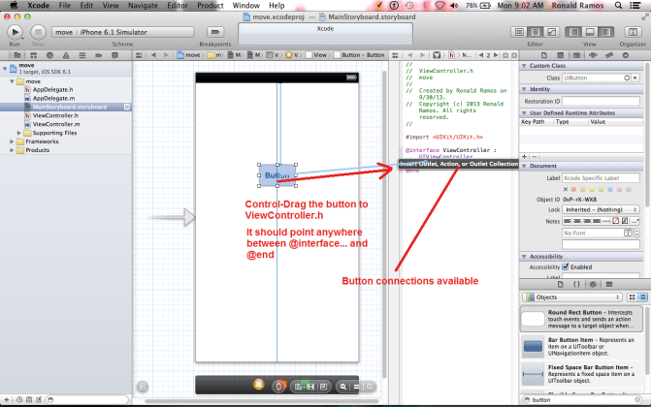
Make the app aware of the button
Notes:
Make sure your code window is split into two. One showing the sotryboard and the other showing the contents of viewcontroller.h
CONTROL-DRAG the button to somewhere in between “@interface ViewController : UIViewController” and “@end”
You will notice the black call-out appear showing options for what it can do with the button.

Slide 69
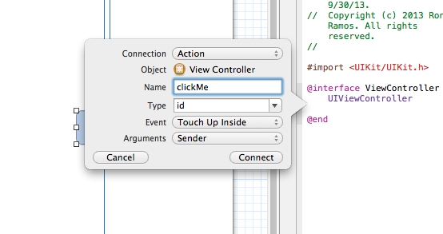
Give the button a name
Notes:
Drop the button anywhere in between @Interface and @end.
The dialogue box above will show up. This is where you define the button and give it a name.

Slide 70
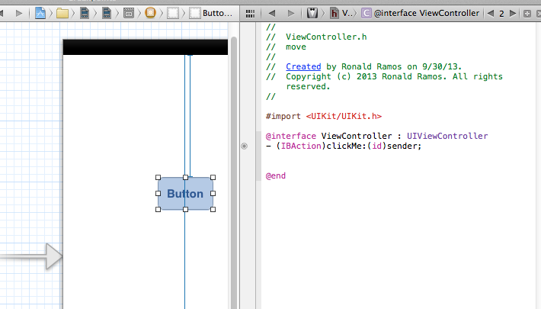
A new line will be inserted in viewcontroller.h
Notes:
After dropping the Button into ViewController.h you will notice that a line of code is added

Slide 71
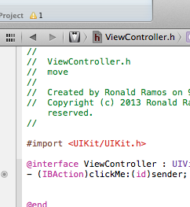
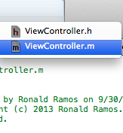
Switch to viewcontroller.m
Notes:
After configuring the Action for the button switch the code window from ViewController.h to ViewController.m
ViewController.h contains the templates for most of the items we will be using in the app.
The actual code resides in ViewController.m

Slide 72
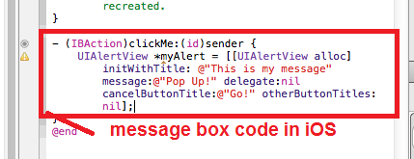
Add the code
Notes:
Complete Code:
UIAlertView *myAlert = [[UIAlertView alloc]
initWithTitle: @"This is my message"
message:@"Pop Up!"
delegate:nil
cancelButtonTitle:@"Go!"
otherButtonTitles:nil];
[myAlert show];

Slide 73
Alert Views
Alert views display a concise and informative alert message to the user. Alert views convey important information about an app or the device, interrupting the user and requiring them to stop what they’re doing to choose an action or dismiss the alert.
Purpose. Alert views allow users to:
  Be immediately informed of critical information
  Make a decision about a course of action
Notes:
For example, iOS uses alerts to warn the user that battery power is running low, so they can connect a power adapter before their workflow is interrupted. An alert view appears on top of app content, and must be manually dismissed by the user before he can resume interaction with the app.

Slide 74
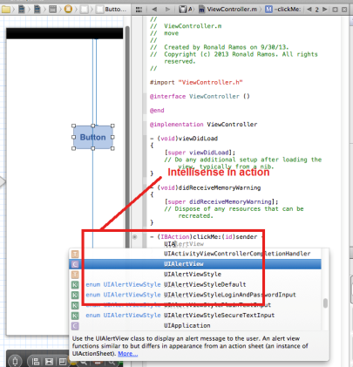
Xcode Autocomplete
Notes:
Just like most good IDEs Xcode has intellisense which helps you out with the code syntax.

Slide 75
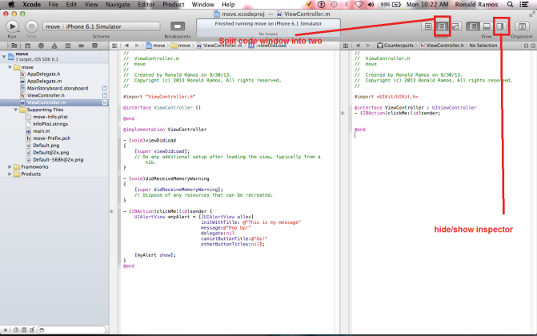
Good practice for coding

Slide 76
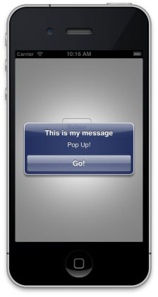
Running the App

